Slide 1



BIG DATA
CONNECTIONIST AI
SUBJECT: COMPUTER SCIENCE & AI
CLASS: ECONOMICS 2

Slide 2







Our team
Members
TEAM LOW TECH
CEO - SWANIE
姓名：阮天娥
CIO - BAOCHI
姓名：吴宝芝
CTO - DARA
姓名：武皇宝玉
DESIGNER - HARVIE
姓名：张玉河
WRITER AND TESTER - LIAM
姓名：阮永松林
---------
---------
---------
---------
---------

Slide 3

Table of
Contents
TEAM LOW TECH
Big Data | Connectionist AI
Introduction to Big Data | Introduction to Connectionist AI
Big Data Technologies | Basics of Neural Networks
Data Processing and Analytics | Architectures of Neural Networks
Data Analysis and Visualization | Deep Learning and Advanced Concepts
Big Data Use Cases | Key Applications
Big Data Ethics and Privacy | Ethical Considerations and Challenges

Slide 4

TEAM LOW TECH
A. BIG DATA

Slide 5

TEAM LOW TECH
I. INTRODUCTION

Slide 6
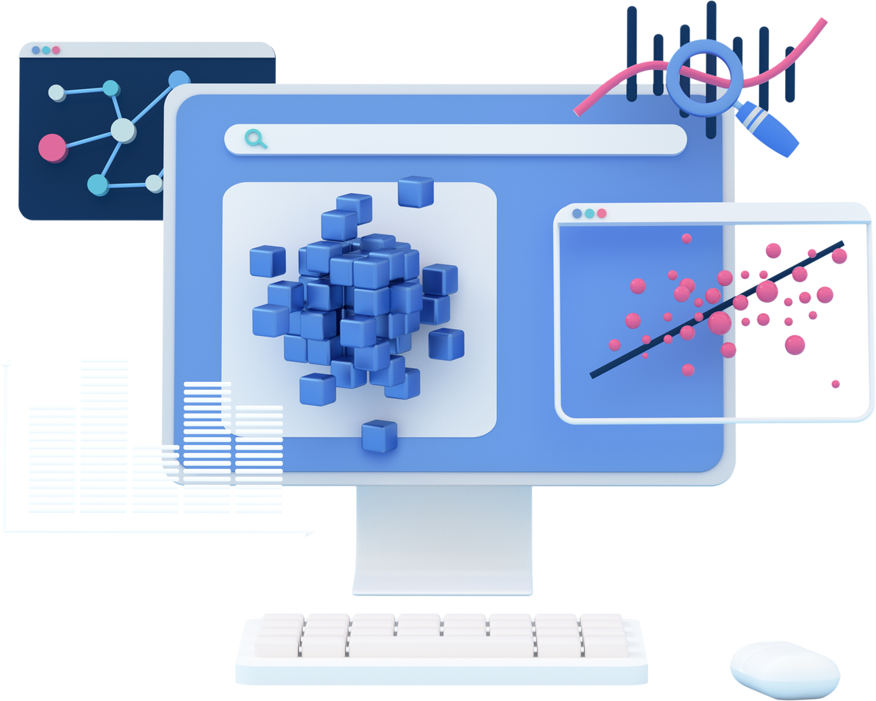
TEAM LOW TECH
What is
Data?
Data refers to raw facts, figures, or pieces of information collected from various sources. It can take many forms, including numbers, text, images, videos, and more
Data is information that has been translated into a form that is efficient for movement or processing
Data by itself often lacks meaning, but when analyzed and processed, it provides valuable insights that can guide decisions and actions

Slide 7

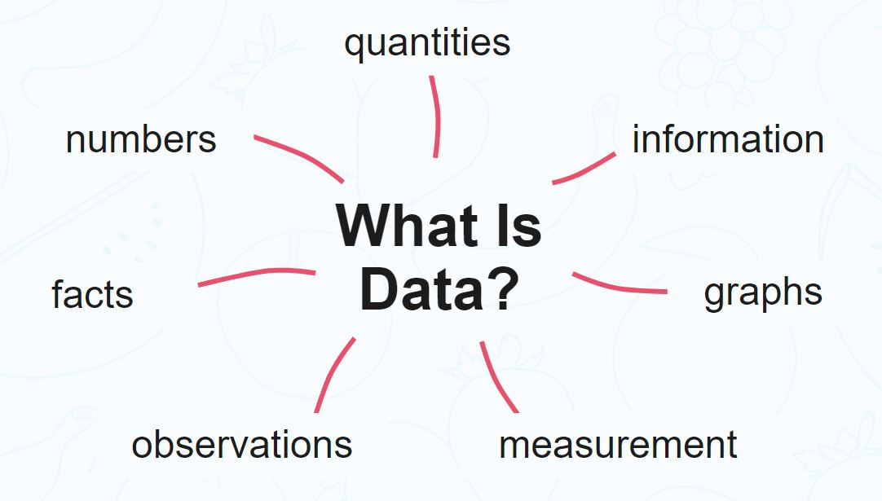
TEAM LOW TECH
According to the Oxford “Data is distinct pieces of information, usually formatted in a special way”
Data can be measured, collected, reported, and analyzed, whereupon it is often visualized using graphs, images, or other analysis tools
Data can be generated by humans, machines or human-machine combines

Slide 8
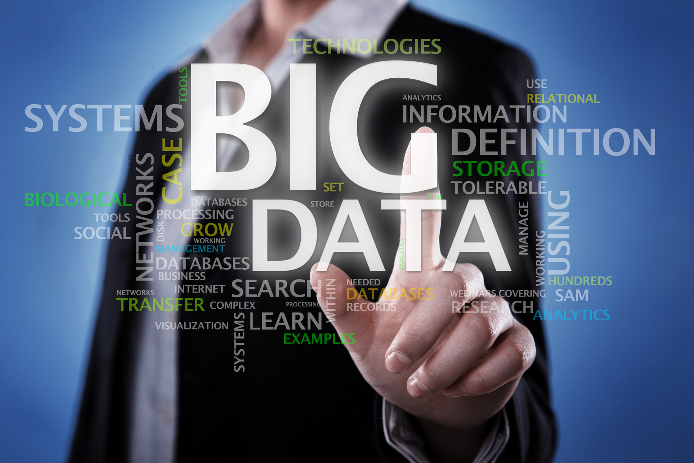
TEAM LOW TECH
What is
Big Data?
Big Data refers to data that is both extremely large in volume and consists of complex datasets that cannot be handled efficiently by traditional data tools
Big Data enables organizations to extract useful insights that can improve decision-making and optimize operations

Slide 9

Differences between
TEAM LOW TECH
Big Data and Traditional Data
SIZE
ORGANIZATION
ARCHITECTURE
SOURCES
ANALYSIS
Traditional Data
Gigabytes or terabytes, single server
Structured, relational databases (SQL)
Centralized, single server
Enterprise-level (ERP, CRM)
Batch processing, post-event analysis
Big Data
Petabytes+, cloud storage needed
Unstructured/semi-structured, NoSQL (MongoDB)
Distributed, scalable (Hadoop)
Social media, IoT, sensors, web data
Real-time, immediate response possible

Slide 10
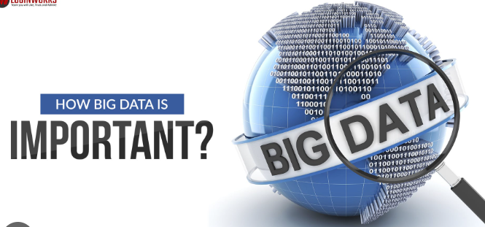
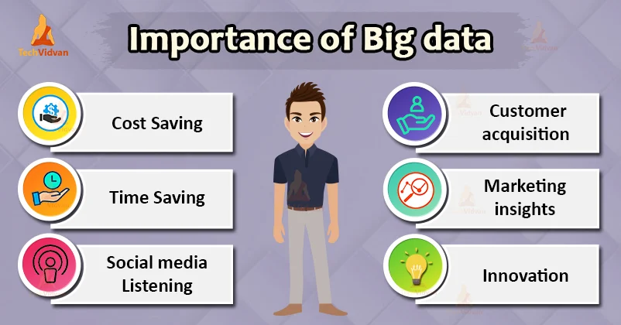
How important
Big Data is?
TEAM LOW TECH
Big Data plays a major role in shaping the organization’s growth
In today’s digital age, the sheer volume of data being generated is staggering. From social media posts to online shopping transactions, every action we generate data
Big data is a game-changer. Its importance lies in its ability to provide valuable insights, enhance decision-making, and drive innovation

Slide 11

TEAM LOW TECH
Evolution of
Big Data
1970s - 2000
2000 - 2010
2010- Present
Early Database
Systems
Web-Based
Data
Mobile Devices & IoT
Relied on Relational Database Management Systems (RDBMS) and data warehouses for structured data. Key concepts like OLTP and OLAP emerged and remain relevant.
The internet and social media introduced semi-structured and unstructured data (e.g., IP addresses, search logs). Companies like Yahoo and Amazon developed techniques like sentiment analysis.
Mobile devices and IoT sensors generate massive data streams (e.g., IIoT, MIoT), demanding real-time analysis to handle behavioral and spatial data.

Slide 12

TEAM LOW TECH
How Big Data works
Integration
Management
Analysis

Slide 13
TEAM LOW TECH
How Big Data works
Integration
Big Data is collected from diverse sources like apps, social media, IoT sensors, and web scraping. It requires preprocessing—cleaning, transforming, and aggregating—before storage and analysis.
Large-scale storage is handled through cloud solutions or on-premises servers. NoSQL databases, like MongoDB, provide flexibility to store various data types without strict schemas, ensuring scalability..
Management
Tools like Hadoop and Spark analyze the data to uncover patterns and insights. AI and machine learning often enhance this process, enabling predictive analytics for business decisions.
Analysis

Slide 14
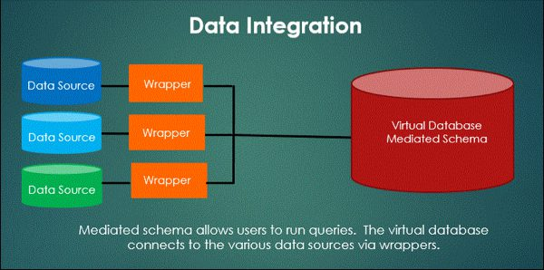
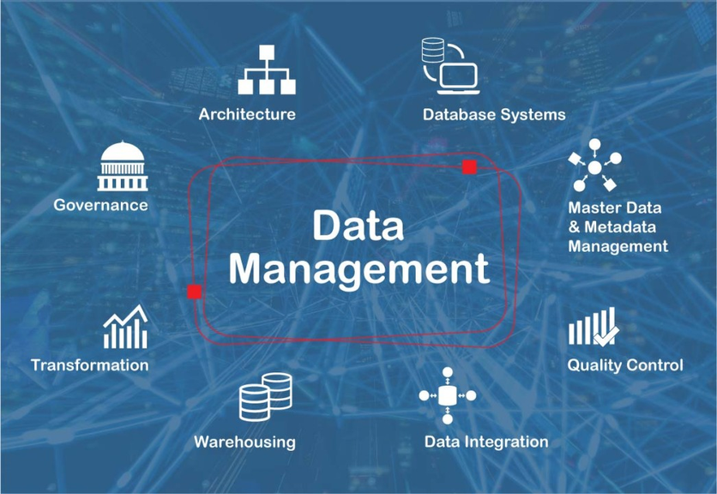
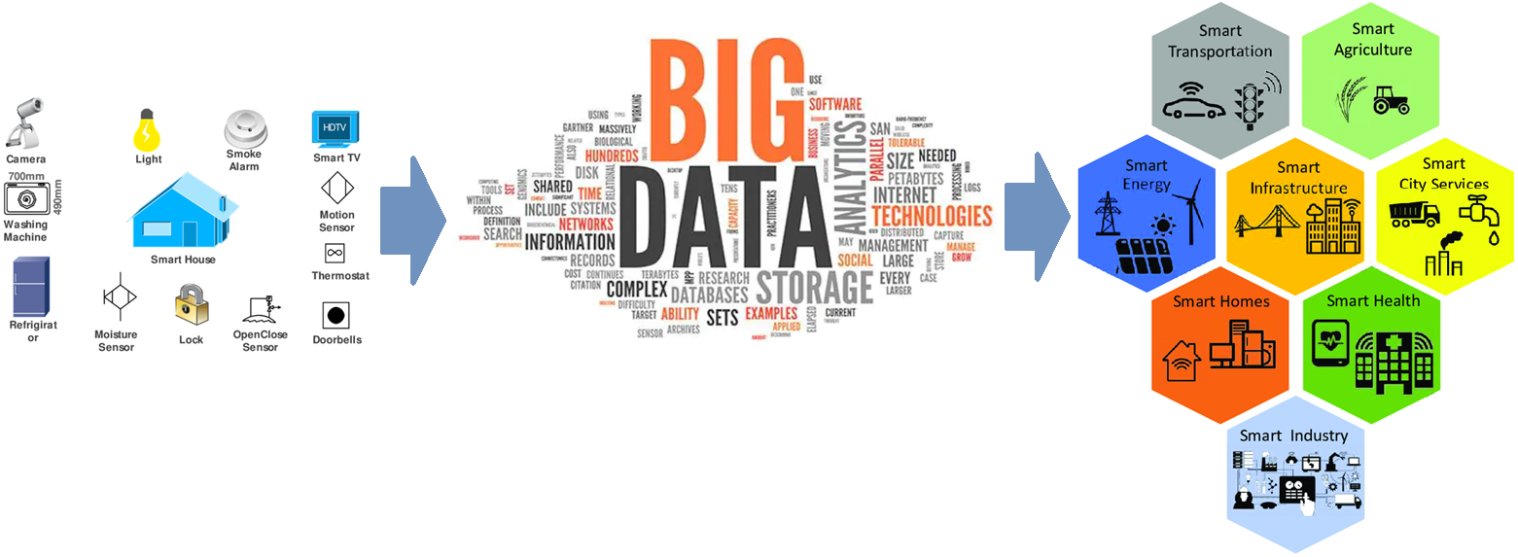
TEAM LOW TECH
How Big Data works

Slide 15
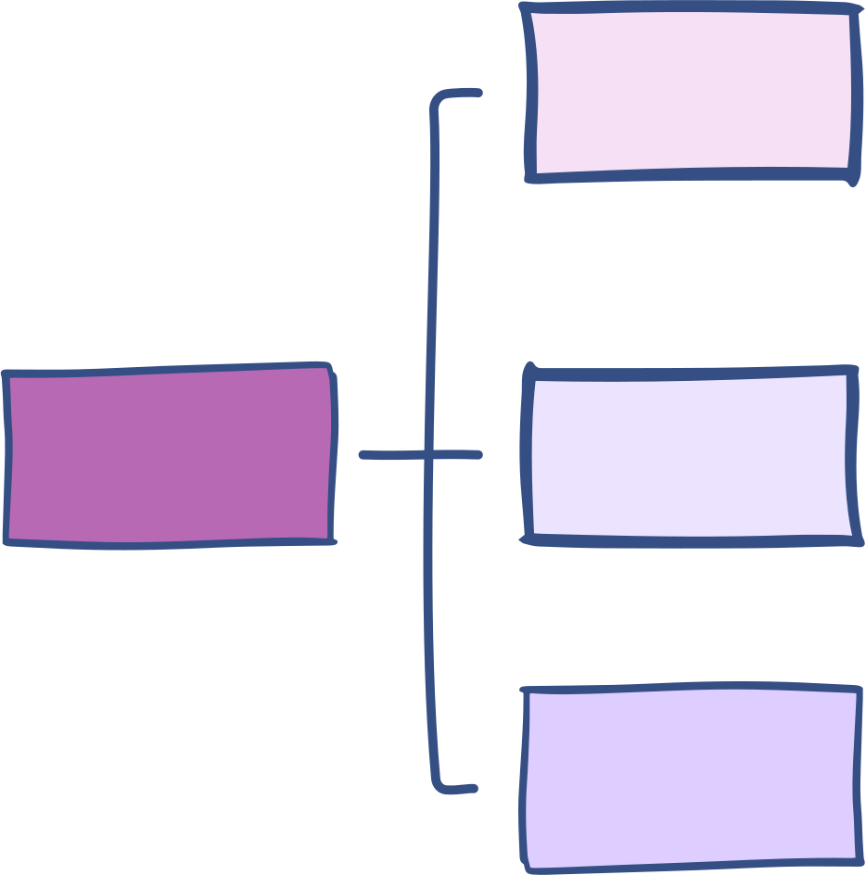
Types of Data
in Big Data
TEAM LOW TECH
Follows a predefined schema or format, typically stored in relational databases using SQL
Around 20% of global data is structured
Easy to manipulate, search, and analyze using traditional tools.
Examples: customer names, financial transactions, dates, times...
STRUCTURED
DATA
Lacks a predefined format or structure, making it difficult to process using traditional tools.
The majority of global data is unstructured (e.g., images, videos, text, social media).
Requires advanced tools such as natural language processing (NLP) or image recognition to extract value.
BIG DATA
UNSTRUCTURED
DATA
Falls between structured and unstructured, containing elements of both. Often found in JSON, XML, and HTML files, which are semi-organized but still require preprocessing before they can be fully analyzed.
Used widely in web applications, IoT devices, and data interchange between systems.
SEMI- STRUCTURED
DATA

Slide 16
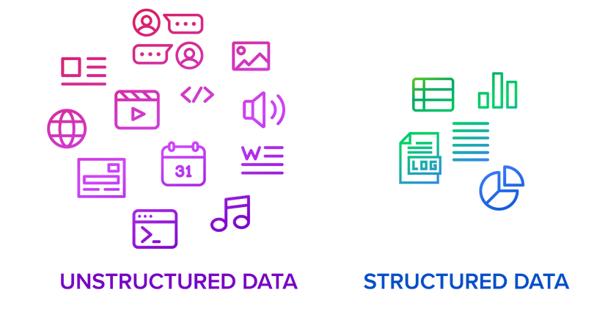
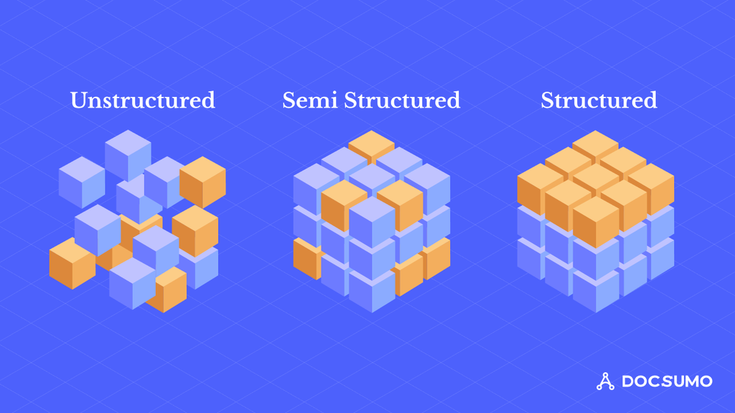
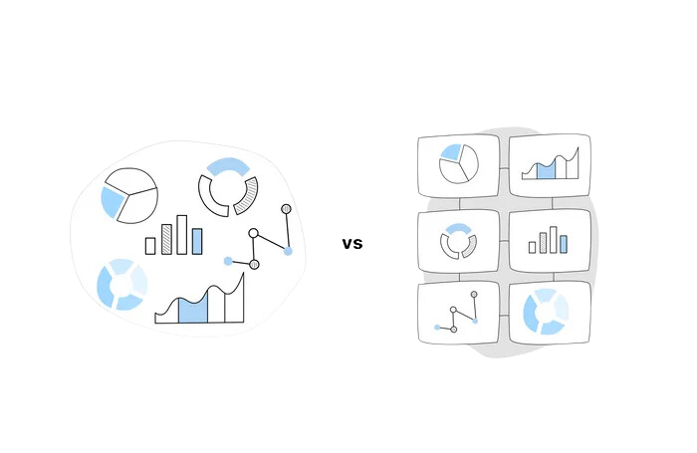
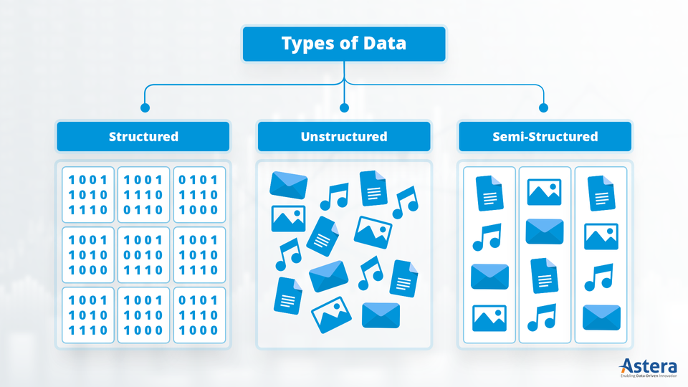
TEAM LOW TECH

Slide 17
Comparison Table
TEAM LOW TECH
Aspect | Structured Data | Semi-Structured Data | Unstructured Data
Format | Rows and columns | Partially organized, tags or markers used | No predefined format or structure
Storage | Relational databases (SQL) | NoSQL databases, XML, JSON files | NoSQL databases, data lakes
Examples | Customer info, financial records | Emails, JSON/XML files, sensor data | Social media posts, videos, IoT data
Processing | Easy to search and analyze | Moderate effort required | Requires advanced tools (AI/ML)
Scalability | Less scalable, fixed schema | More scalable than structured data | Highly scalable, dynamic schema
Flexibility | Rigid and predefined structure | Some flexibility with structure | Adaptable to changing data types
Analysis | Simple queries with SQL | Needs intermediate tools | Requires complex tools (Hadoop, Spark)

Slide 18

TEAM LOW TECH
Key Characteristics
of Big Data
VOLUME
Big Data is characterized by the 5Vs: large volumes of data (Volume), rapidly generated and processed (Velocity), coming in diverse formats (Variety).
Its quality may vary (Veracity), but the focus is on extracting valuable insights (Value) for decision-making.
VELOCITY
5Vs
VARIETY
VERACITY
VALUE

Slide 19
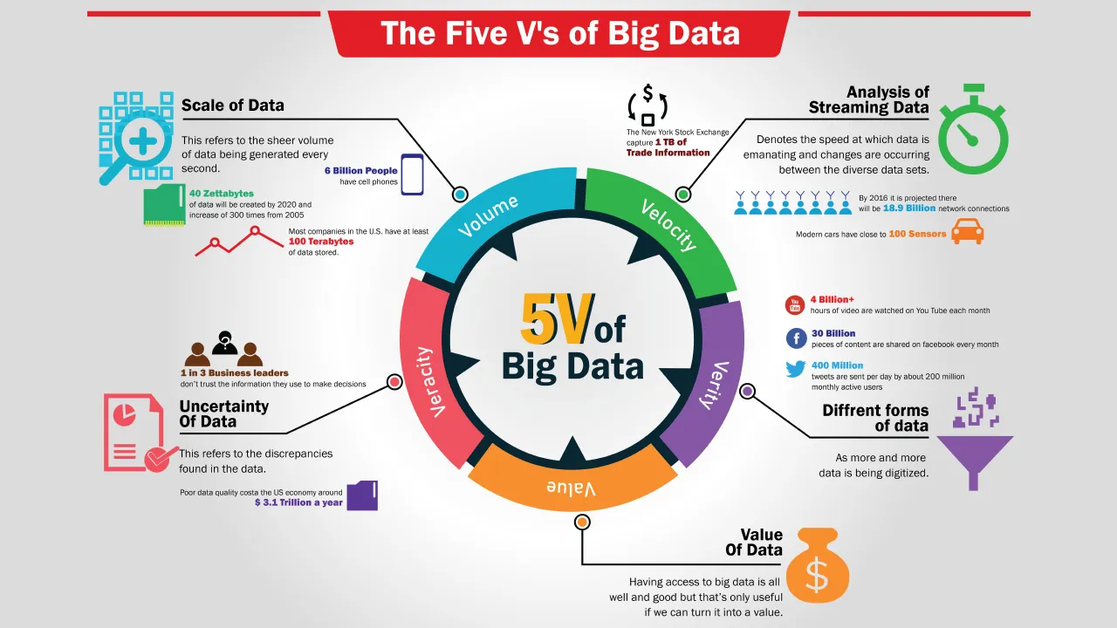
TEAM LOW TECH

Slide 20
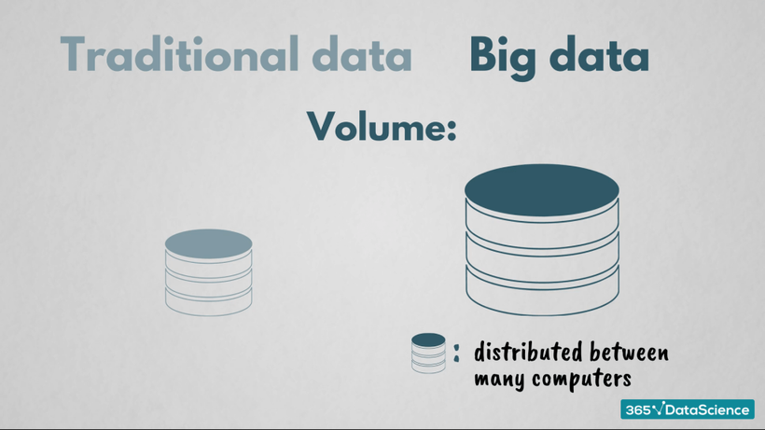
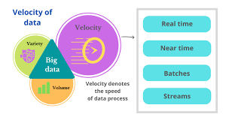
What are
5Vs about?
TEAM LOW TECH
VOLUME
Refers to the sheer quantity of data generated, such as the 44 zettabytes in 2020. By 2025, daily data generation is expected to reach 463 exabytes.
VELOCITY
The speed at which data is created and processed, such as the 18.7 billion text messages generated daily and 4 petabytes of data from Facebook every day. Real-time analysis tools are needed to capture and act on data at this speed.

Slide 21
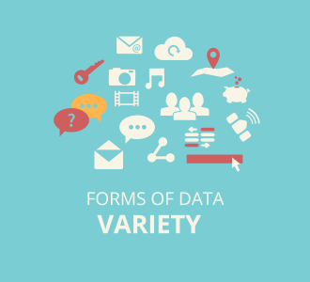
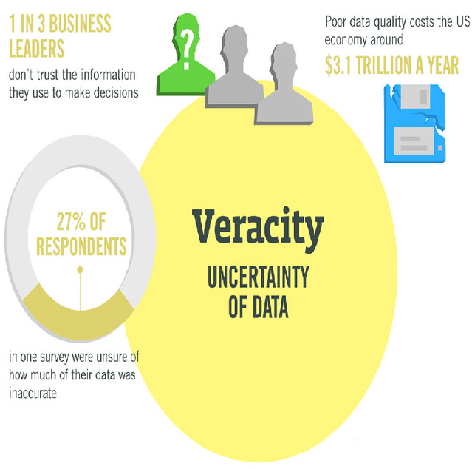
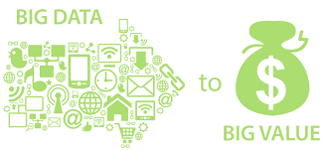
TEAM LOW TECH
VARIETY
Big Data comes in many forms, including structured, unstructured, and semi-structured formats. For example, text, audio, video, and images are all common forms of unstructured data.
VERACITY
Refers to the reliability and accuracy of data. Big Data is prone to uncertainty and errors, requiring careful validation and quality control to ensure insights are actionable.
VALUE
The utility of data lies in its ability to provide insights. Not all Big Data is valuable, so organizations must filter and preprocess data to extract useful information relevant to their needs.

Slide 22
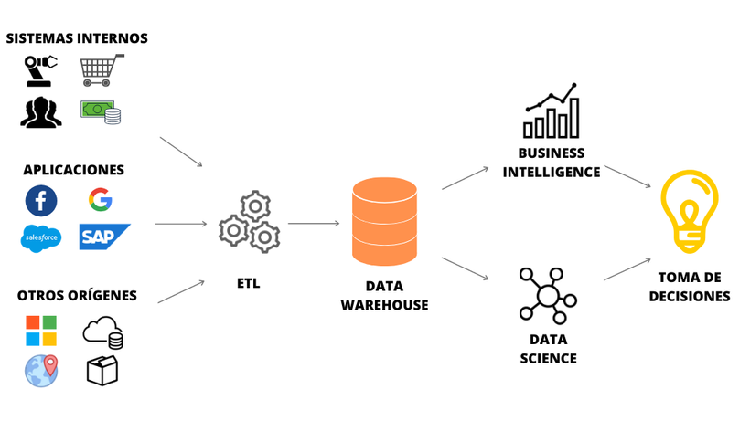
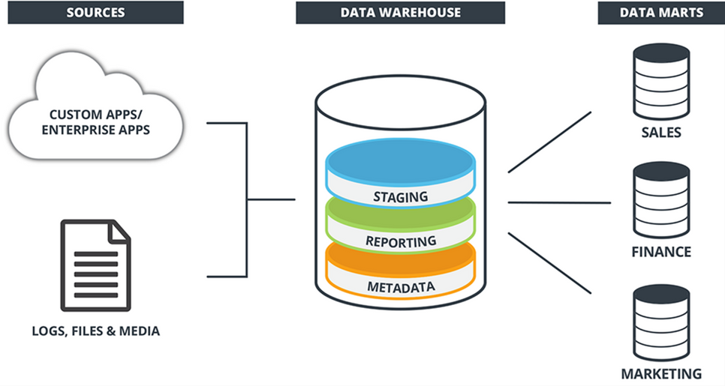
Data
TEAM LOW TECH
Warehouse
WHAT IS DATA WAREHOUSE?
Data warehouse (DW or DWH), also known as an enterprise data warehouse (EDW), is a system used for reporting and data analysis and is a core component of business intelligence.
Data warehouses are central repositories of data integrated from disparate sources. They store current and historical data organized so as to make it easy to create reports, query and get insights from the data.
Unlike databases, they are intended to be used by analysts and managers to help make organizational decisions

Slide 23
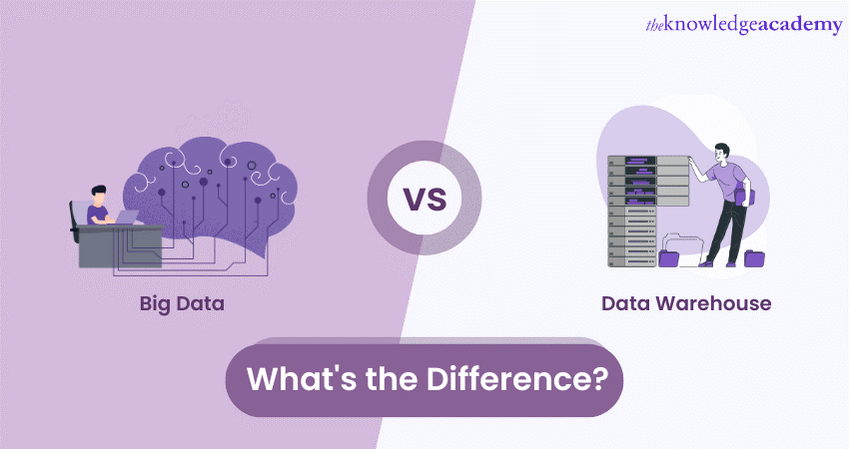
TEAM LOW TECH

Slide 24
Differences between
TEAM LOW TECH
Big Data and Data Warehouse
Aspect | Big Data | Data Warehouse
Data Type | Structured, semi-structured, unstructured (e.g., text, video, social media). | Primarily structured data from business operations.
Purpose | Real-time analytics for immediate actions. | Historical analysis for strategic decisions.
Processing | Uses tools like Hadoop, Spark for large, complex data. | Relies on SQL queries for structured data.
Storage | Distributed systems (cloud, NoSQL). | Centralized relational databases.
Scalability | Highly scalable for growing data sources. | Less scalable, designed for stable data.
Speed | Optimized for real-time processing. | Batch processing, focusing on past data.
Sources | IoT, social media, streaming services. | Internal systems (ERP, CRM).
Use Case | Predictive analytics, streaming data. | Business reports, trend analysis.
Cost | Higher due to complex infrastructure. | More cost-efficient for stable data needs.

Slide 25

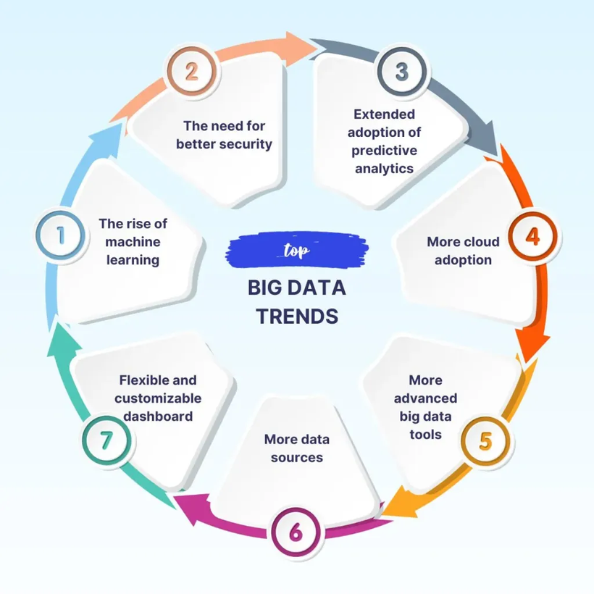
TEAM LOW TECH
Big Data
Future Trends
Technological
Innovations
Cloud and Data Infrastructures
Analytics and Business Value
Governance
and Security
Automation and Democratization

Slide 26
TEAM LOW TECH
Big Data
Future Trends
Technological
Innovations
Cloud and Data Infrastructures
Analytics and Business Value
How big data is processes and analyzed
AI and Machine Learning
Quantum Computing
Edge Computing and IoT Integration
How companies store and manage data at scale
Hybrid Cloud Solutions
Data Lakes and Lakehouses
Data Fabric Architecture
How data can be used to derive actionable insights and drive decion-making
AI and Machine Learning
Quantum Computing
Edge Computing and IoT Integration
Governance
and Security
Automation and Democratization
Managing data responsibly and ensuring regulatory compliance.
Stricter Data Governance
Data Ethics and Bias Mitigation
Makeing advanced analytics accessible to non-experts through automation and user-friendly tools.
AutoML and Low-Code Platforms
Data as a Service (DaaS)

Slide 27
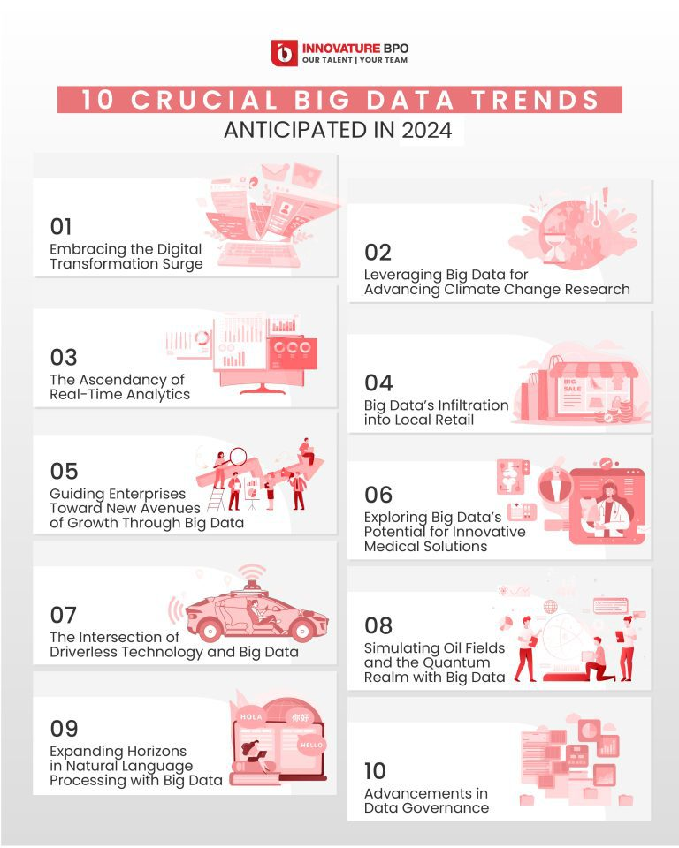
TEAM LOW TECH
Big Data
Future Trends
According to Innovature BPO, these are 10 crucial big data trends across areas:
Digital Transformation Surge
Climate Change Research
Real-Time Analytics
Local Retail
Enterprise Growth
Medical Solutions
Driverless Technology
Oil Fields & Quantum
Natural Language Processing (NLP)
Data Governance

Slide 28


TEAM LOW TECH
II. BIG DATA
TECHNOLOGIES

Slide 29
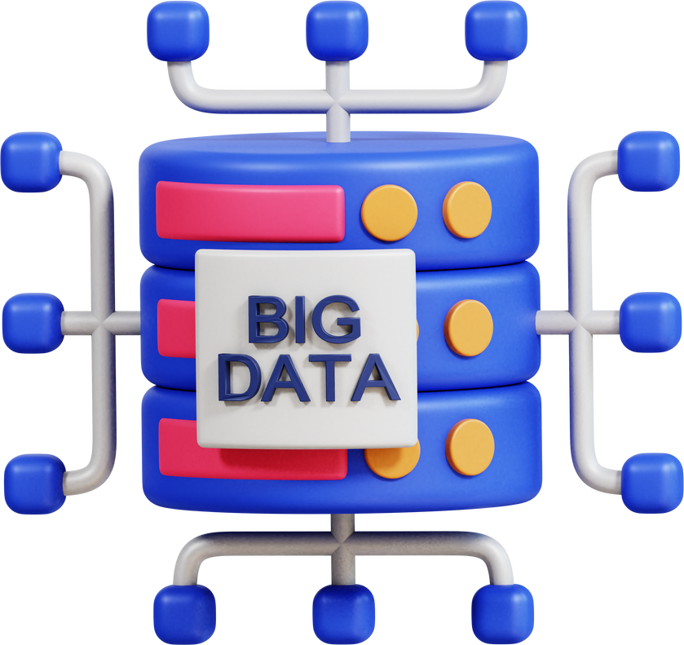
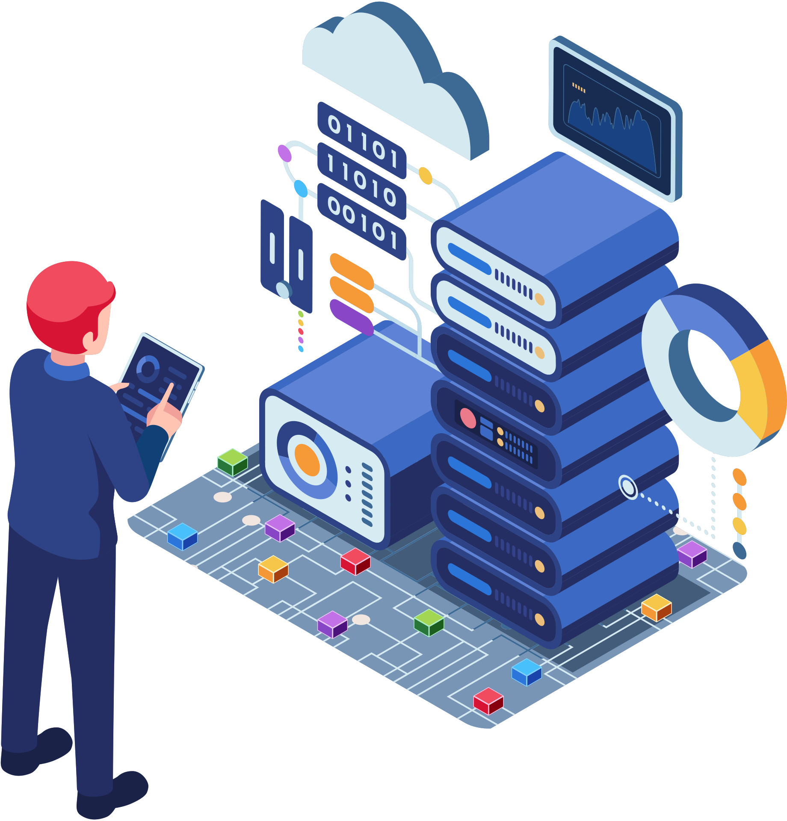
TEAM LOW TECH
What is
Big Data Technology?
Big Data Technologies refer to a collection of tools, frameworks, and techniques that are used to store, process, analyze, and manage extremely large and complex datasets that cannot be handled efficiently by traditional systems.
These technologies enable businesses, governments, and organizations to extract meaningful insights from massive volumes of structured, semi-structured, and unstructured data.

Slide 30
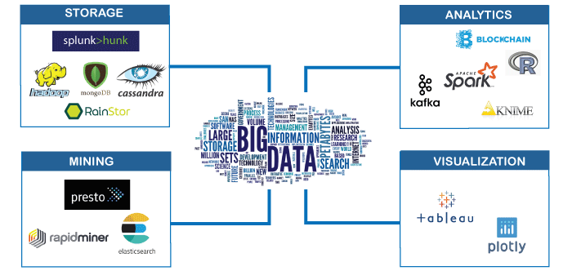
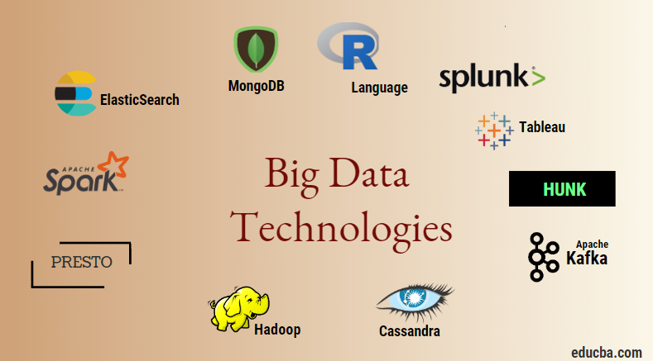
TEAM LOW TECH
What is
Big Data Technology?
Big data technology encompasses everything related to data analytics, processing, and extraction: intricate data structures, uncover hidden patterns, and provide crucial business insights.
When combined with other intelligent technologies like the Internet of Things (IoT), machine learning (ML), and artificial intelligence (AI), big data tools become even more powerful.

Slide 31
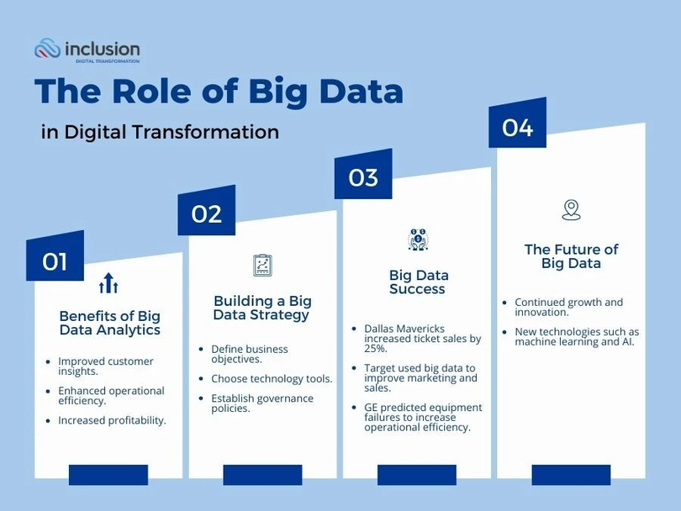
TEAM LOW TECH
The Role of Big Data Technologies
in today’s world
Approximately 2.5 quintillion bytes of data are created every day
Big Data really is ubiquitous these days, and sometimes we might not even realize how much it affects our everyday lives. It is getting harder and harder to function in normal society without the presence of Big Data somehow in your life.
Technologies associated with Big Data are changing the way we lead our lives, carry out work. They contributed a lot towards real-time processing, gaining insights, and innovation giving a competitive edge to organizations irrespective of their sector.

Slide 32
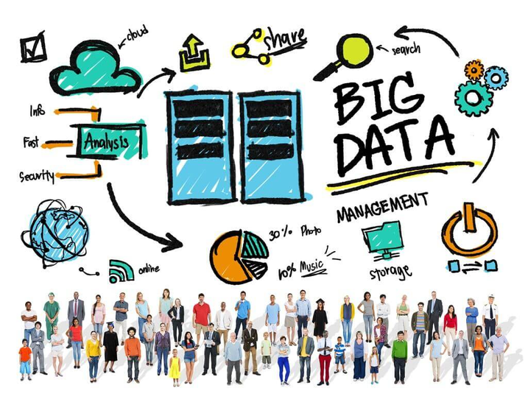

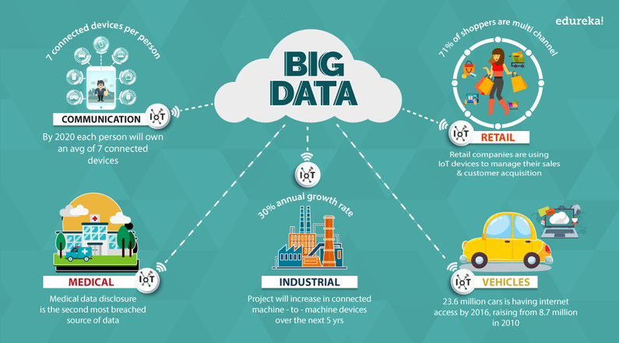
TEAM LOW TECH
The Role of Big Data Technologies
in today’s world
The impact of Big Data technology is very significant in a variety of industries:
TRANSFORMING BUSINESS OPERATIONS AND DECISION-MAKING
REVOLUTIONIZING HEALTHCARE AND LIFE SCIENCES
ADVANCING FINANCIAL SERVICES AND FRAUD DETECTION
ENABLING SMART CITIES AND ENVIRONMENTAL SUSTAINABILITY
ENHANCING EDUCATION AND LEARNING SYSTEMS
REVOLUTIONIZING MANUFACTURING AND SUPPLY CHAINS
POWERING GOVERNMENT AND PUBLIC SERVICES

Slide 33

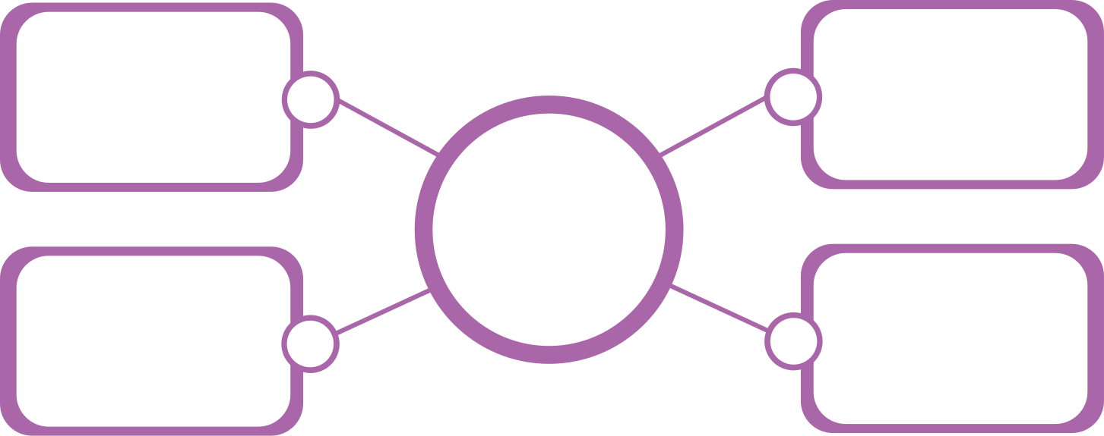
Big Data Technologies
TEAM LOW TECH
Categorization
BY HOW DATA IS USED
BY FUNCTIONS & PROCESSES
Operational
Big Data
Data
Storage
Data
Mining
BIG
DATA
BIG
DATA
Data
Analytics
Data
Visualization
Analytical
Big Data

Slide 34

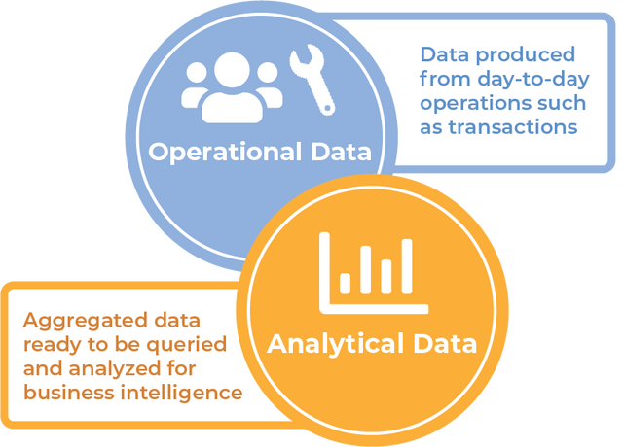
Big Data Technologies
TEAM LOW TECH
Categorization
BY HOW DATA IS USED
Focusing on how data is used and applied in the context of business or operations rather than the tools themselves, Big Data technology is primarily classified into the following two types: OPERATIONAL BIG DATA and ANALYTICAL BIG DATA.
Both types serve distinct purposes and require different tools, infrastructure, and techniques.
Operational
Big Data
BIG
DATA
Analytical
Big Data

Slide 35
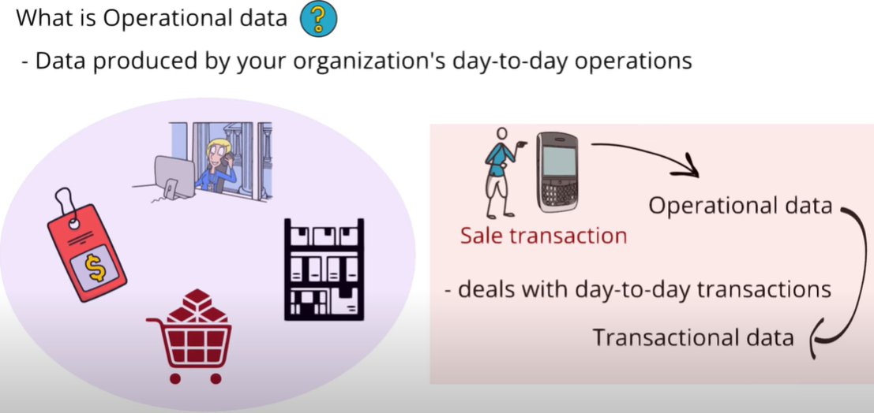
Big Data Technologies
TEAM LOW TECH
Categorization
Operational Big Data
Operational Big Data refers to technologies and systems used to support day-to-day business operations by managing high-velocity, real-time data streams.
This type of data is typically constantly (real-time) data generated by various sources such as online transactions, IoT sensors, social media platforms, and mobile applications.
BIG
DATA

Slide 36
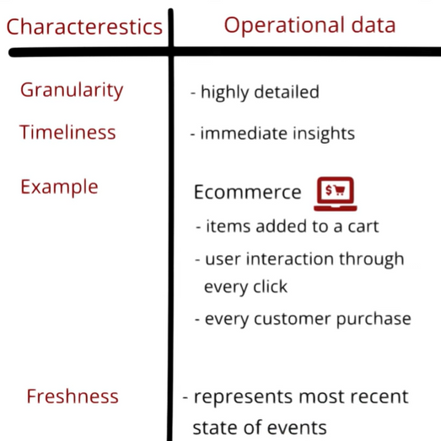
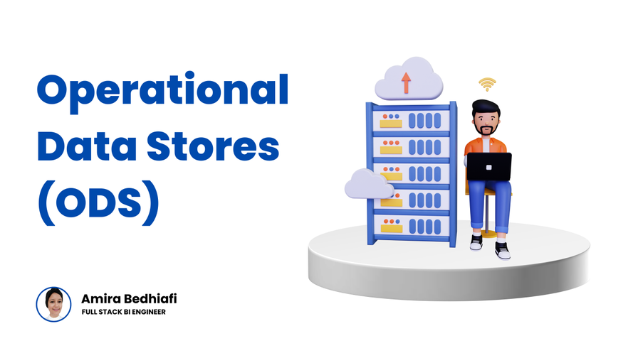
TEAM LOW TECH
Operational Big Data
Key Features
Real-time data generation: Data from social media, sensors, IoT devices, transactions, etc.
Data handling: These technologies ensure the continuous collection, storage, and organization of data.
Transactional systems: Often involve databases that support frequent read and write operations, as the data is continuously being updated
BIG
DATA
Use Cases
E-commerce: Customer transaction data, product inventory, and website logs are examples of operational data that need to be managed in real-time.
Social Media: Continuous streams of user activity, likes, shares, and comments are operational data that require fast processing and storage.

Slide 37
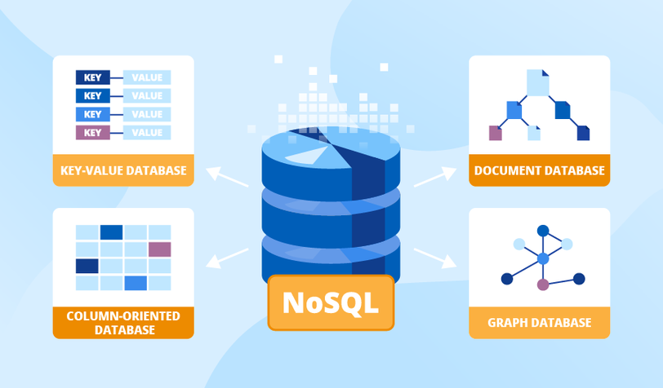
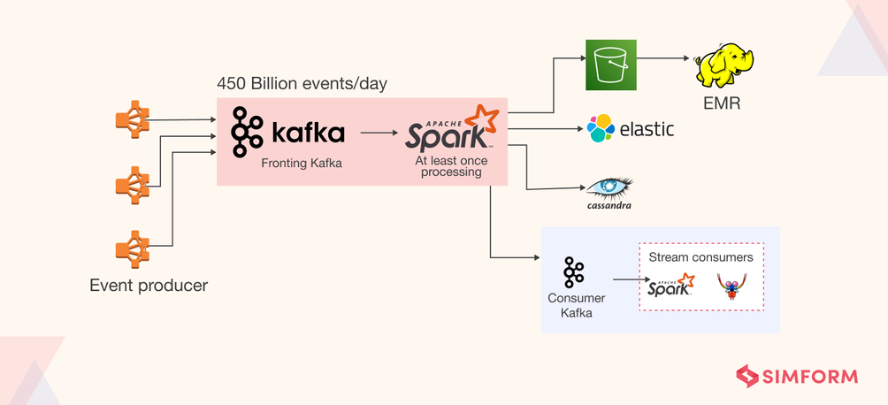
TEAM LOW TECH
Operational Big Data
Key Technologies
Databases for Operational Use:
NoSQL Databases like MongoDB, Cassandra, and Couchbase are optimized for handling unstructured or semi-structured data at scale.
Relational Databases (e.g., MySQL, PostgreSQL) can also manage operational data but might struggle with high-velocity data streams.
2. Stream Processing Systems:
Tools such as Apache Kafka and Apache Flink are used to process data in real time.
These systems support event-driven architectures and real-time messaging, crucial for operational activities like fraud detection or stock updates.
BIG
DATA

Slide 38
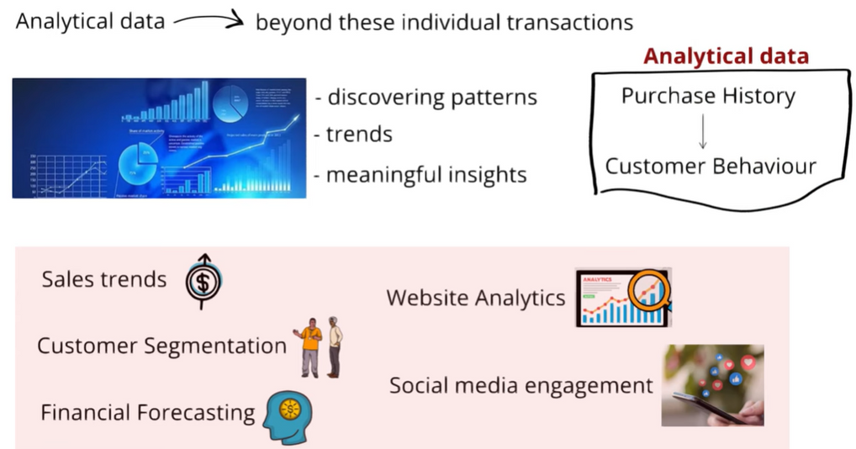
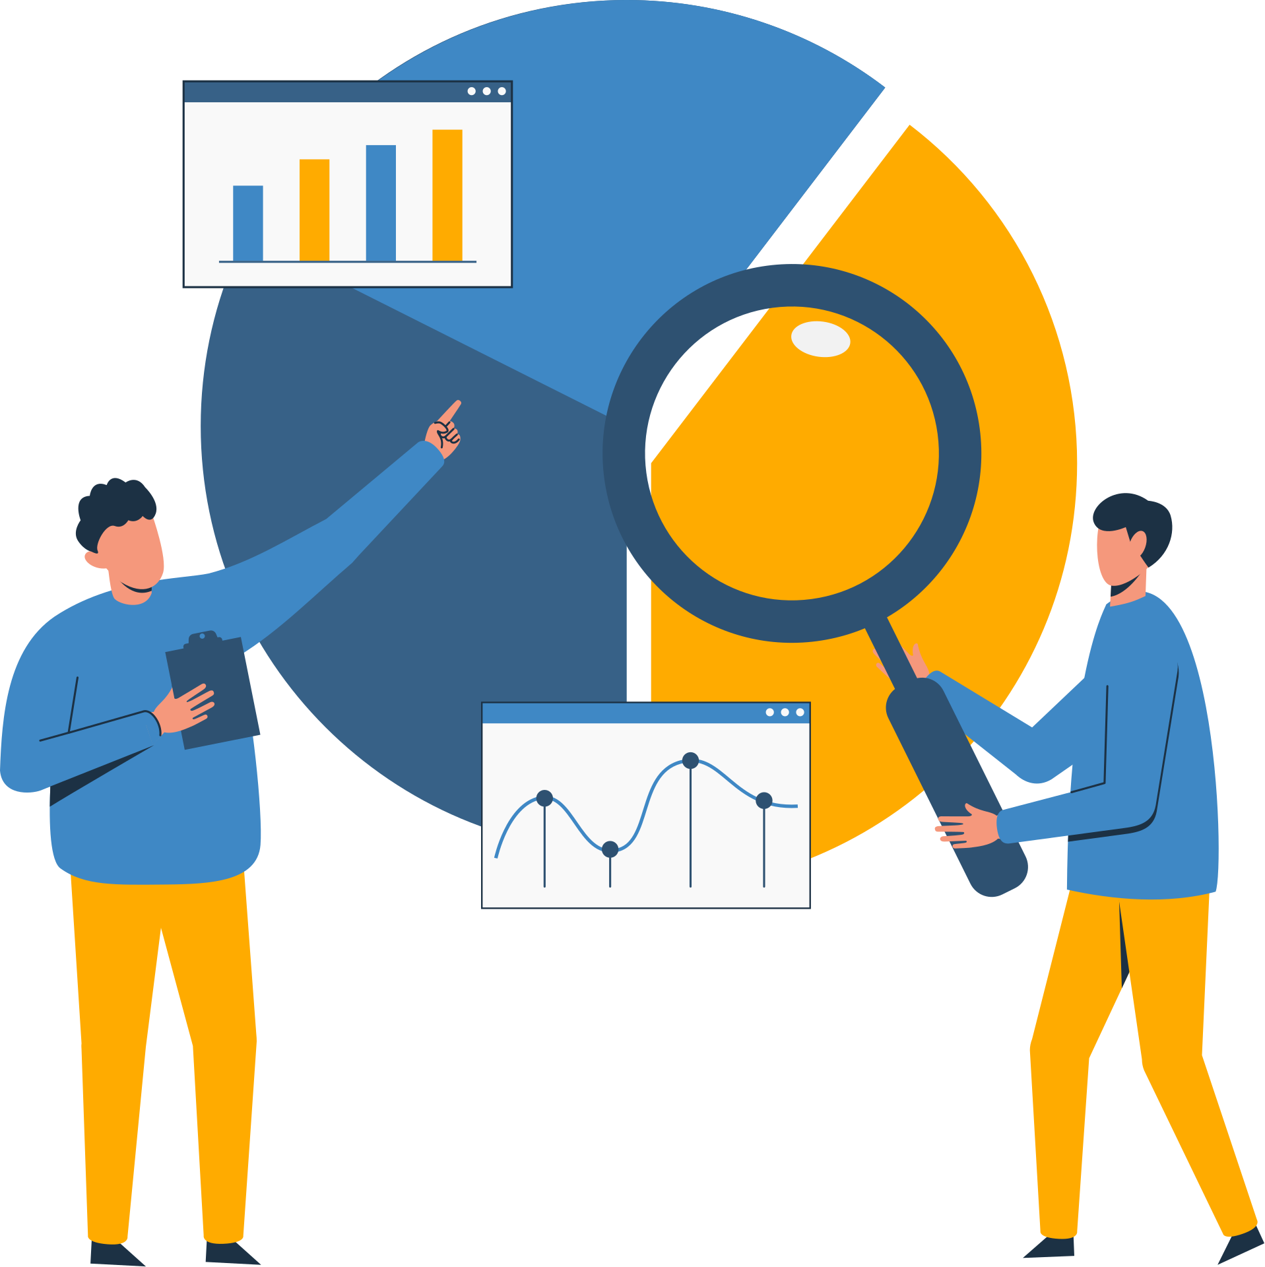
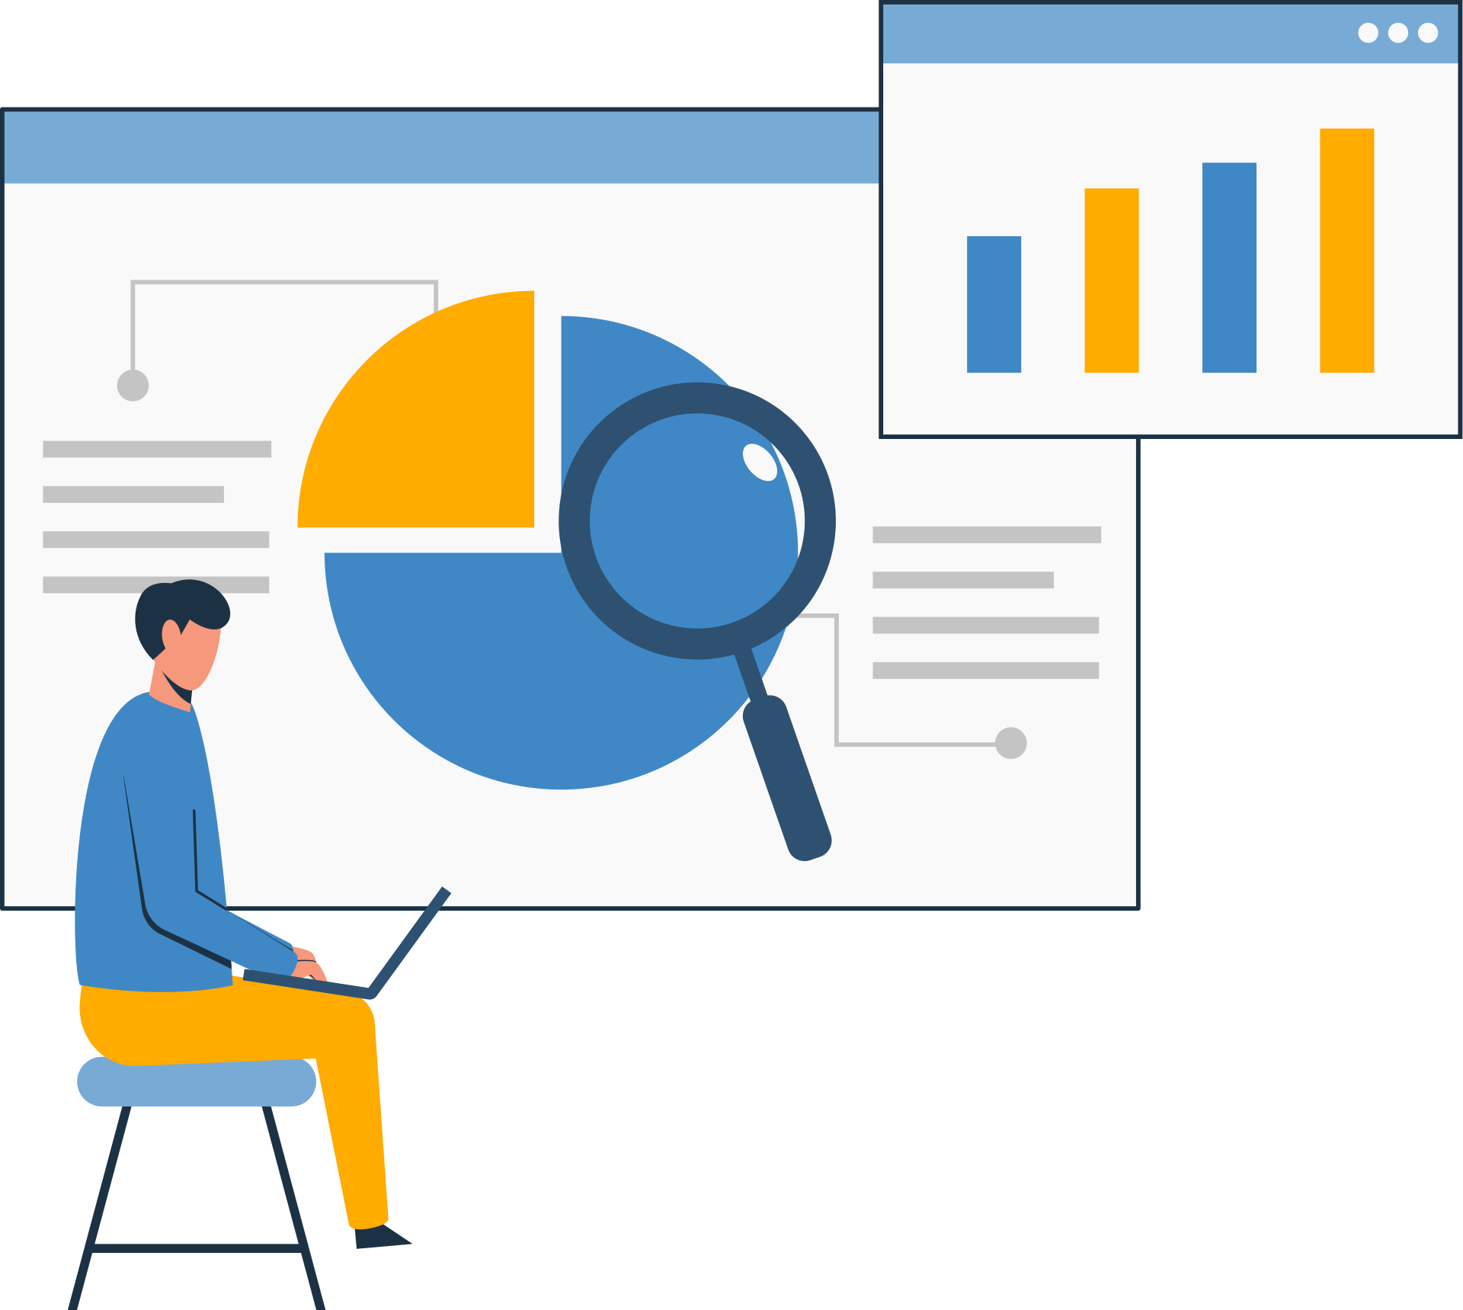
Big Data Technologies
TEAM LOW TECH
Categorization
Analytical Big Data
Analytical Big Data refers to technologies and processes focused on analyzing historical data to derive insights, trends, and patterns. Unlike operational data, analytical data is typically collected over time, aggregated, and used for strategic planning and decision-making.
Focuses on historical data for in-depth analysis and decision-making. Analytical Big Data focuses on the processing and analyzing of large-scale data to extract insights and support decision-making. The data in this context is often historical and used for in-depth analysis rather than real-time operations

Slide 39
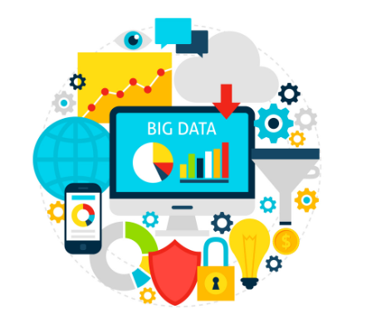
TEAM LOW TECH
Analytical Big Data
Key Characteristics
Batch or Historical Data Processing: Data is processed in large batches instead of in real time.
High Volume: Analytical data includes large datasets accumulated over time.
Complex Queries and Computation: Involves running sophisticated algorithms for trend analysis, machine learning, and predictions.
Longer Processing Times: While real-time responses aren’t required, the focus is on extracting deep insights from large datasets.

Slide 40
TEAM LOW TECH
BY HOW DATA IS USED
Aspect | Operational Big Data | Analytical Big Data
Purpose | Supports real-time operations | Provides insights and supports decision-making
Data Types | Current, transactional, or streaming data | Historical, aggregated data
Processing Type | Real-time or near-real-time | Batch processing
Key Technologies | NoSQL databases, Kafka, Flink | Hadoop, Spark, data warehouses
Examples | Online banking, IoT platforms | Predictive analytics, business reporting

Slide 41
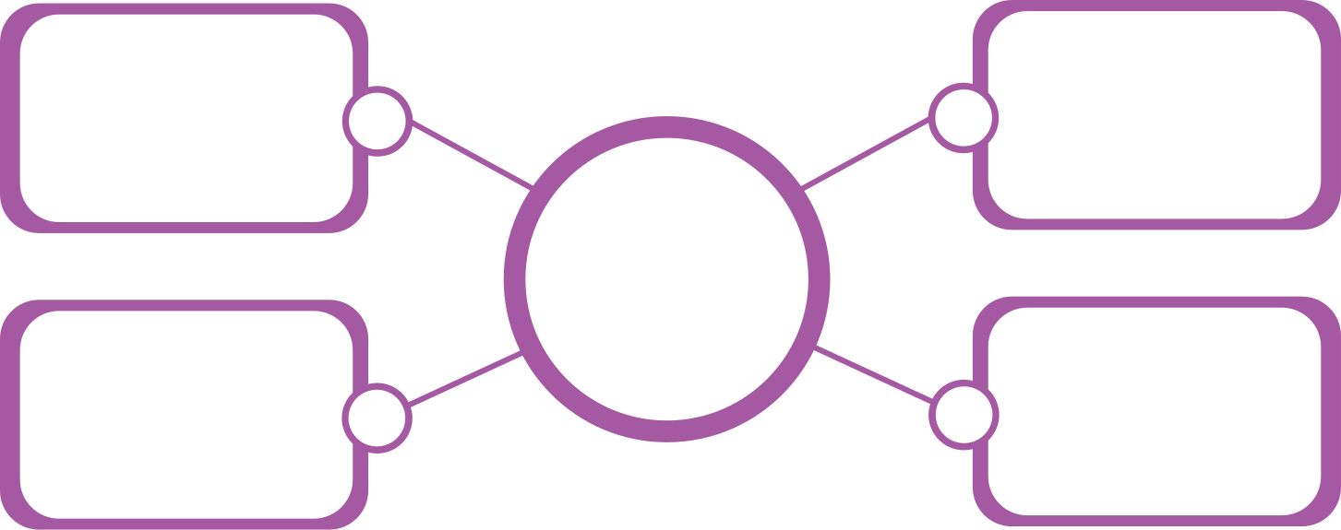
Big Data Technologies
TEAM LOW TECH
Categorization
BY FUNCTIONS & PROCESSES
Big Data technologies can also be categorized based on their core functions and processes into four key types: Data Storage, Data Mining, Data Analytics, and Data Visualization. Each type addresses a specific phase in the big data lifecycle, from storing raw data to extracting insights and presenting them in a user-friendly manner.
Data
Storage
Data
Mining
BIG
DATA
BIG
DATA
Data
Analytics
Data
Visualization

Slide 42
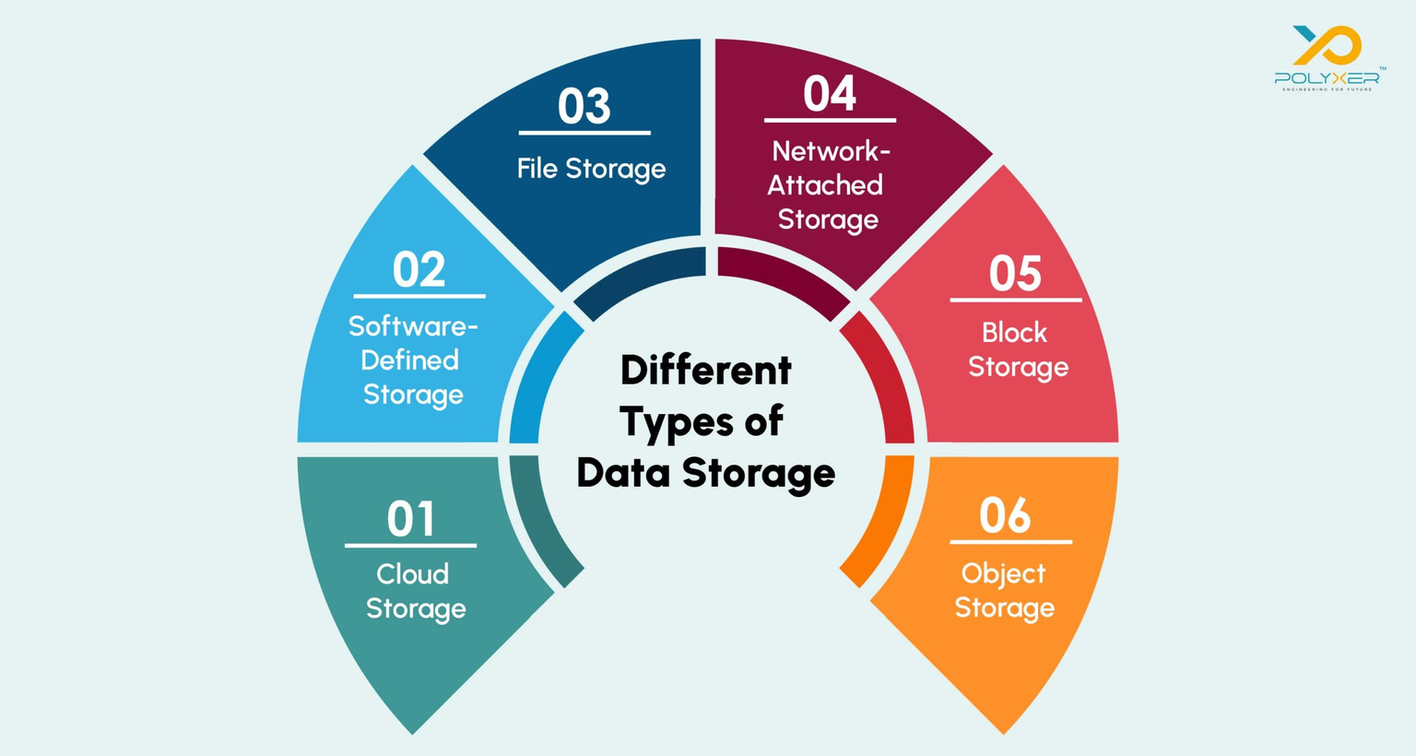
Big Data Technologies
TEAM LOW TECH
Categorization
DATA STORAGE TECHNOLOGIES
Data storage tech manages large datasets effectively as big data grows. Scalable, distributed systems are needed.
Foundation of big data technology: Collect, organize, manage data across systems efficiently.

Slide 43
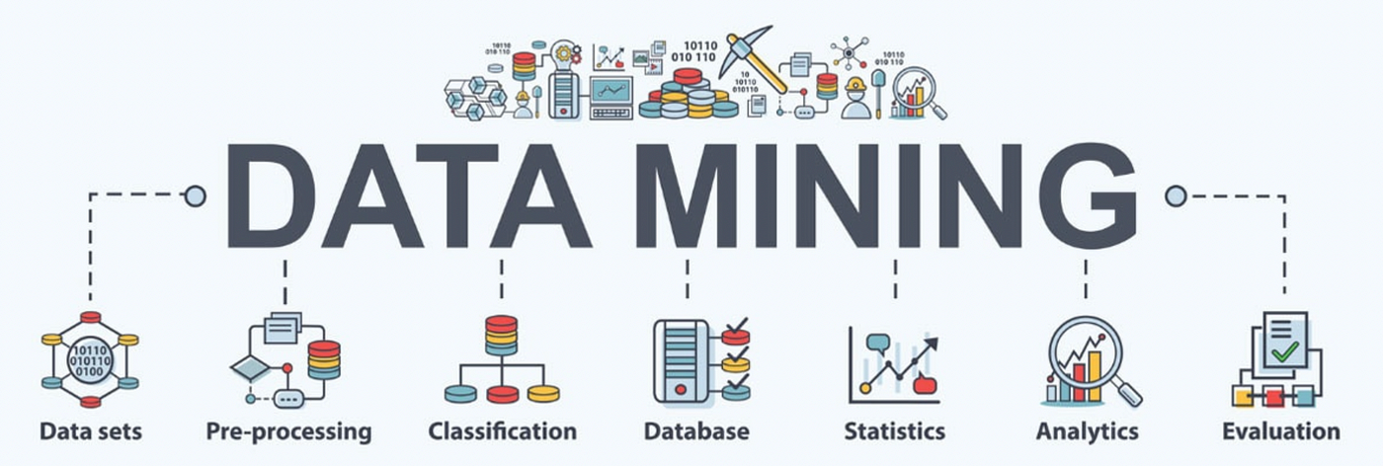
Big Data Technologies
TEAM LOW TECH
Categorization
DATA MINING TECHNOLOGIES
Data mining focuses on extracting hidden patterns, relationships, and useful insights from raw data. This process involves using advanced algorithms to uncover trends that are not immediately apparent, often serving as a precursor to analytics

Slide 44
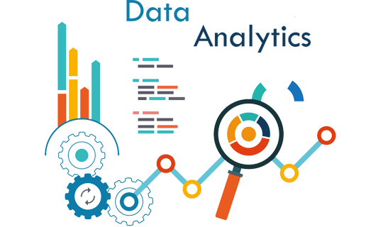
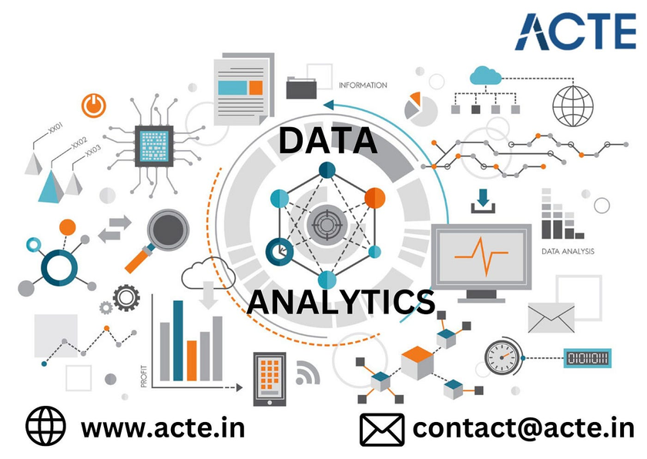
Big Data Technologies
TEAM LOW TECH
Categorization
DATA ANALYTICS
Data analytics involves processing and analyzing datasets to derive insights and answer specific business questions. It can be further classified into descriptive, predictive, and prescriptive analytics.

Slide 45
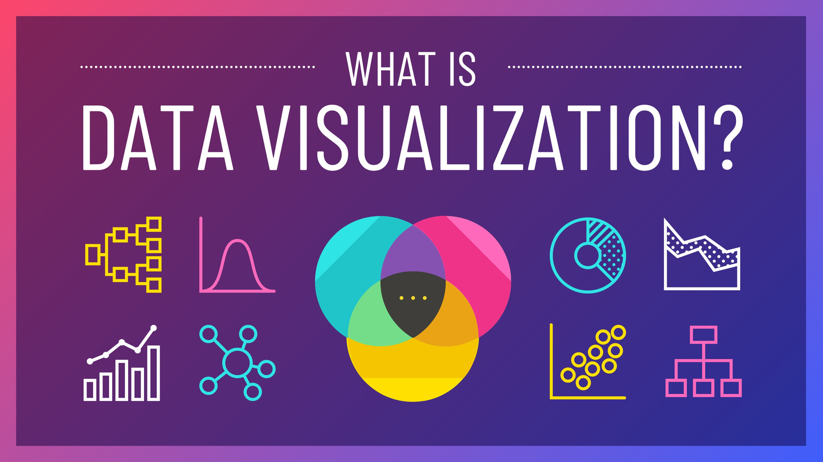
Big Data Technologies
TEAM LOW TECH
Categorization
DATA VISUALIZATION
Data visualization involves representing data insights through charts, graphs, dashboards, and other visual formats. This makes complex data easier to understand and enables decision-makers to grasp trends quickly.

Slide 46









Real-world use cases
TEAM LOW TECH
by leading companies
Big data technologies play a critical role across many industries, driving innovation, optimizing operations, and enabling smarter decision-making.
Many leading companies and big corporations leverage various Big Data technologies to handle their vast data and analytics needs.
Apache Hadoop
& BigQuery
Apache Hive
& Presto
Apache Cassandra & Apache Flink
Redshift, DynamoDB,
and EMR
Apache Spark
& Hadoop
Apache Kafka &
Apache Samza
MaxCompute and Flink
Power BI and
Azure Cosmos DB

Slide 47

Real-world use cases
TEAM LOW TECH
by leading companies
Netflix has over 150 million subscribers, and collects data on all of them. They track what people watch, when they watch it, the device being used, if a show is paused, and how quickly a user finishes watching a series.
They even take screenshots of scenes that people watch twice. Why? Because by feeding all this information into their algorithms, Netflix can create custom user profiles. These allow them to tailor the experience by recommending movies and TV shows with impressive accuracy.

Slide 48

Real-world use cases
TEAM LOW TECH
by leading companies
Big data isn’t just used to tailor online experiences. A good example of this is McDonald’s, who use big data to shape key aspects of their offering offline, too. This includes their mobile app, drive-thru experience, and digital menus.
With its own app, McDonald’s collects vital information about user habits. This lets them offer tailored loyalty rewards to encourage repeat business. But they also collect data from each restaurant’s drive-thru, allowing them to ensure enough staff is on shift to cover demand.
Finally, their digital menus offer different options depending on factors such as the time of day, if any events are taking place nearby, and even the weather.

Slide 49

Real-world use cases
TEAM LOW TECH
by leading companies
Amazon collects vast amounts of data on its users. They track what users buy, how often (and for how long) they stay online, and even things like product reviews
Amazon can even guess people’s income based on their billing address. By compiling all this data across millions of users, Amazon can create highly-specialized segmented user profiles.
Using predictive analytics, they can then target their marketing based on users’ browsing habits. This is used for suggesting what you might want to buy next, but also for things like grouping products together to streamline the shopping experience.

Slide 50


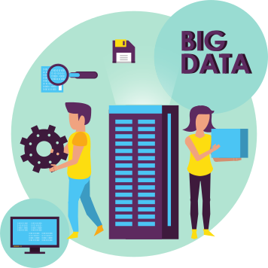
TEAM LOW TECH
Challenges in implementing
Big Data Technologies
Data Quality and Consistency
Storage and Processing within a Specified
Timespan
Data Security
and Privacy
CHALLENGES
Data Integration from Diverse Sources
Scalability and Cost Management

Slide 51
TEAM LOW TECH
III. Data Processing & Analytics

Slide 52


TEAM LOW TECH
DATA PROCESSING

Slide 53
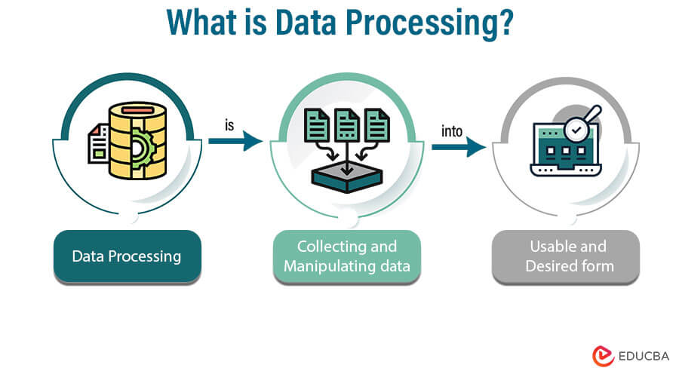
TEAM LOW TECH
Definition of
Data Processing
Big data processing covers collecting, storing, and managing massive amounts of data (mostly in a semi- or unstructured form) that arrives from multiple sources.
Big data processing stages include several stages, including data collection, data preparation, data input, data transformation, data interpretation and data storage.
Processed big data is used to derive insights (including real-time) and trigger immediate automated actions.

Slide 54


TEAM LOW TECH
1. Data Collection
Data collection is the first step in the data processing pipeline. It involves gathering data from various sources such as databases, sensors, social media platforms, transactions, and logs.
a. The process of Data Collection
Gathering information
Cleaning data, preparing for analysis
Extracting specific data in a structured format

Slide 55



1. Data Collection
TEAM LOW TECH
b. Tools for Data Collection
AI and machine learning algorithms play a key role in extracting valuable insights from big data. They detect patterns, predict outcomes, and automate decisions.
Utilizing AI and ML enables organizations to enhance their data collection, analysis, and interpretation processes, giving them a competitive edge.
EXAMPLES:
Apache Kafka: Kafka for high-throughput, low-latency data streaming.
Apache NiFi: Tool for automating data flow between systems with user-friendly interface.

Slide 56



TEAM LOW TECH
1. Data Collection
c. Challenges when collecting data
As data volume and diversity grow, firms must enhance security to prevent breaches.
Managing vast amounts of big data requires scalable infrastructure and powerful computing.
Data Protection and Security Challenges
Managing Big Data volume
Protecting sensitive information requires investing in cybersecurity, complying with data laws, and implementing encryption techniques.
Cloud solutions and frameworks like Hadoop and Spark offer affordable, scalable options. Ensuring data quality and usability is also essential.

Slide 57

TEAM LOW TECH
2. Data Preparation
Data preparation involves cleaning and transforming raw data before analysis. This crucial step often includes reformatting, correcting, and merging datasets to enhance the data.
Although it can be time-consuming for data engineers or business users, it's necessary to contextualize the data, convert it into insights, and reduce bias from low data quality.

Slide 58

TEAM LOW TECH
2. Data Preparation
a. Advantages
High-quality data output
Quick error
resolution
Improved business decisions
Enhanced scalability
ADVANTAGES
Future readiness
Faster data access and teamwork

Slide 59


TEAM LOW TECH
2. Data Preparation
b. Steps
Collecting Data
Explore and Evaluate Data
Clean and Verify Data
Data transformation & enrichment
Store Data

Slide 60

TEAM LOW TECH
3. Data Input
What is Data Input and How important it is?
The Data Input stage of Big Data refers to the process of collecting, ingesting, and storing large volumes of diverse data from various sources for further processing and analysis. This stage is crucial because it sets the foundation for the subsequent steps in the Big Data lifecycle.
It involves gathering large amounts of raw data from various sources, cleaning it, and ensuring it is ready for analysis and processing in the subsequent stages.

Slide 61
TEAM LOW TECH
3. Data Input
Breakdown of the key aspects
Key Aspects | Description
Data Sources | Data comes from sources like social media, sensors, transactional systems, log files, IoT devices, and databases. It can be structured, semi-structured, or unstructured.
Data Ingestion | Ingestion gathers data and transports it to Big Data systems (e.g., Hadoop, Spark). It can occur in batch mode (at intervals) or real-time/streaming (as produced).
Data Storage | Data is stored using distributed systems like Hadoop’s HDFS, cloud storage (e.g., AWS S3), or NoSQL databases (e.g., Cassandra, MongoDB). These systems ensure scalability, fault tolerance, and fast access.
Data Quality & Cleaning | Data is cleaned and validated to remove duplicates, handle missing values, and correct errors. High data quality is essential for reliable analysis.

Slide 62


TEAM LOW TECH
4. Data Transformation
Definition
Data transformation is the process of converting, cleansing, and structuring data into a format for analysis, aiding decision-making and organizational growth
This is a process that removes duplicates, alters data types, and enhances raw data. It involves structure definition, mapping, extraction, transformations, and storage.

Slide 63


TEAM LOW TECH
4. Data Transformation
Data transformation can be:
Constructive: Adding, copying, or replicating data
Destructive: Deleting records and fields
Aesthetic: Standardizing specific values
Structural: Renaming, moving, and combining columns
The converted data is assessed to ensure it meets the intended format requirements.

Slide 64


TEAM LOW TECH
4. Data Transformation
Techniques in Data Transformation
Aggregation: Summarizing data by grouping it and calculating metrics such as sum, average, or count.
Encoding: Converting categorical variables into numerical representations (e.g., one-hot encoding).
Scaling: Adjusting the range of variables to ensure uniformity in analysis.
Tools for Data Transformation
Apache Spark: A distributed processing system that provides APIs for large-scale data transformation tasks. Its in-memory computation capabilities make it fast for iterative processing.
Pandas: A Python library used for data manipulation and transformation, offering Data Frames and various functions to transform and analyze datasets efficiently.

Slide 65



TEAM LOW TECH
4. Data Transformation
Advantages Disadvantages
Data can significantly impact an organization's efficiency and profitability by understanding customer behavior, internal processes, and industry trends.
Errors and inconsistencies in data transformation stem from missing values, incorrect formats, or mismatched schemas, affecting integration and analysis if not properly addressed.

Slide 66

TEAM LOW TECH
5. Data output
Overview: the process of analyzing and deriving meaningful insights
Steps: analysis -> Identifying Trends and Patterns -> Hypothesis Testing -> Contextualization -> Visualization -> Decision-Making
Methods: qualitative and quantitative
Benefits: helps companies understand their performance and consumer perception, enabling them to work on solutions to improve their performance

Slide 67
TEAM LOW TECH
DATA ANALYTICS

Slide 68

TEAM LOW TECH
1. Data Analytics
Overview: a process that transforms raw data into actionable insights
Provides visibility
Deeper understanding of processes

Slide 69

TEAM LOW TECH
2. Descriptive Analytics
Information provided: a historical overview of a business's operations
Uses descriptive analytics to analyze posts on social media only determines patterns, not inferences or predictions
How it works: collecting relevant data, managing it, and preparing it for data analytics

Slide 70

TEAM LOW TECH
3. Steps, Pros and Cons
Advantages: allows side-by-side comparisons, Variables like production costs
Disadvantages: can't predict market forces, supply and demand changes; struggle to interpret data
Select Metrics
Gather Data
Compile Data
Analyze Data
Present Findings

Slide 71

TEAM LOW TECH
4. Diagnostic Analytics
Define
Advantages: identify the root; improves processes, solves problems, and mitigates risks
Drawbacks: can be challenging to analyze; not predicting future events
Tools: R, Python, Tableau, Microsoft Excel, SAS, Alteryx, and QlikView
1
Collect
2
Preprocess
3
EDA
4
Visualization
5
Recommendation
6

Slide 72

TEAM LOW TECH
5. Predictive Analytics
Overview: a branch of advanced analytics, identify risks and opportunities
Types: Classification Models, Clustering models, Time series models
Advantages: data security, risk reduction, efficient workflows, predictive analytics
Define
Collect and organize
Preprocess
Develop predictive models
Validate and deploy results

Slide 73

TEAM LOW TECH
6. Prescriptive Analytics
Define
Overview: a data analytics method, unlike descriptive analytics which examines outcomes post-fact
Advantages: navigate uncertainty, prevent fraud, limit risk, increase efficiency, meet goals, and build customer loyalty
Drawbacks: suitable for short-term solutions and unreliable for long-term ones
Integrate
Develop the model
Deploy
Take action

Slide 74
TEAM LOW TECH
IV. Data Analysis & Visualization

Slide 75
TEAM LOW TECH
Data Analysis

Slide 76


TEAM LOW TECH
1. What is Data analysis?
Definition: The process of collecting, cleaning, organizing, and interpreting data to extract useful information.
Purpose: Provides insights into trends, correlations, and patterns that help businesses, researchers, and organizations make informed decisions.
Key Processes:
Applications: Widely used in fields like healthcare, finance, marketing, and logistics.
Descriptive Analysis
Diagnostic Analysis
Predictive Analysis
Prescriptive Analysis

Slide 77
TEAM LOW TECH
2. Key Steps In Big Data Analysis

Slide 78

TEAM LOW TECH
STEP 1: Data Collelction
Importance of Accurate Data Collection: The first and most critical stage. Inaccurate data collection affects the entire analytics process.
Data Sources:
Structured Data: Well-organized data in relational databases (e.g., SQL databases, financial records).
Unstructured Data: Raw data like emails, social media, images, videos, etc. (e.g., social media posts, IoT devices).
Semi-Structured Data: Data formats like XML and JSON that aren’t fully structured.

Slide 79
TEAM LOW TECH
Real-Time vs. Batch Data Collection
Real-Time Data:
Definition: Data collected and processed as it is created (e.g., IoT sensors, stock market feeds).
Use Cases: Critical in fields such as financial trading, healthcare monitoring, and logistics where immediate decision-making is required.
Technologies: Kafka, Flink, Kinesis for real-time data streams.
Batch Data:
Definition: Data collected and processed at scheduled intervals (e.g., overnight processing of server logs, daily sales reports).
Use Cases: Useful for long-term trend analysis, such as monthly sales reporting or customer behavior analysis.

Slide 80

TEAM LOW TECH
Dark Data and IoT in Data Collection
Dark Data:
Definition: Data that organizations collect but never use (e.g., call recordings, surveillance footage).
Impact: Missed insights and opportunities, potential cybersecurity risks.
Internet of Things (IoT):
Definition: Smart devices and sensors that generate vast amounts of real-time data.
Examples: Smart thermostats, industrial sensors, healthcare monitors.
Challenge: Handling and analyzing massive streams of sensor data in real-time.

Slide 81
TEAM LOW TECH
STEP 2: Data Cleaning and Preparation

Slide 82

Data Processing and Analysis
TEAM LOW TECH
Key Concept: If poor-quality data is used, the resulting analysis will be flawed, no matter how sophisticated the model.
Importance: Clean data ensures accurate and actionable insights.
Steps in Data Cleaning:
Remove duplicate records, fix inconsistencies, handle missing values, and eliminate errors.
Example: Correcting typos or filling missing dates in a sales dataset.

Slide 83

TEAM LOW TECH
Handling Outliers and Missing Values
Outliers:
Definition: Data points that significantly differ from others in a dataset.
Importance: Outliers can indicate critical insights like fraud, equipment malfunctions, or errors in data entry.
Example: A large spike in bank withdrawals could signal fraud.
Missing Values:
Impact: Missing data can weaken the quality of analysis.
Imputation Techniques: Use statistical models (mean, median) or machine learning algorithms to fill gaps.

Slide 84

TEAM LOW TECH
Data Normalization and Augmentation
Data Normalization:
Definition: The process of scaling different variables to a common scale without distorting their relationships.
Use Case: Especially important in datasets with varying measurement units (e.g., currency, weight, time).
Data Augmentation:
Definition: Expanding datasets by generating new examples from existing data (e.g., rotating or flipping images in computer vision).
Use Case: Often used in machine learning to improve model accuracy.

Slide 85
TEAM LOW TECH
STEP 3: Data Processing and Analysis

Slide 86

TEAM LOW TECH
Importance of Data Processing
Goal: Convert raw data into actionable insights.
Steps in Data Processing:
Filtering and aggregating data, transforming data formats, and applying statistical models.
Tools for Data Processing: Hadoop, Spark, and other distributed systems enable fast and efficient analysis of large datasets.

Slide 87

TEAM LOW TECH
Parallel and Distributed Processing
Definition: Processing large datasets using multiple machines working together.
Tools:
Hadoop: Distributes tasks across servers, manages big data processing.
Apache Spark: In-memory data processing for real-time analytics.
Use Cases: Processing petabytes of data in fields like weather forecasting, genomic sequencing, or social media analysis.

Slide 88

TEAM LOW TECH
Statistical Analysis Techniques
Methods:
Descriptive Statistics: Summarizes data features like mean, median, and mode.
Inferential Statistics: Predicts or infers population traits from samples.
Hypothesis Testing: Assesses statistical significance of observed patterns.
Regression Analysis: Analyzes relationships between variables, such as marketing spend and sales impact.

Slide 89
TEAM LOW TECH
STEP 4: Predictive and Prescriptive Analytics

Slide 90

TEAM LOW TECH
Predictive Analytics
Definition: Uses historical data to forecast future outcomes (e.g., predicting customer churn).
Techniques:
Time Series Analysis: Predicting future values based on historical data (e.g., sales forecasting).
Predictive Modeling: Uses machine learning algorithms to predict future behavior.

Slide 91

TEAM LOW TECH
Prescriptive Analytics
Definition: Provides recommendations based on predicted outcomes (e.g., suggesting marketing strategies).
Techniques:
Optimization Models: Recommend the best course of action by evaluating different scenarios.
Example: A retailer uses prescriptive analytics to decide the best product pricing strategy based on competitor behavior.

Slide 92
TEAM LOW TECH
Data Visualization

Slide 93
TEAM LOW TECH
1. What is Data Visualization?
Definition: Graphical representation of data using visual elements (charts, graphs, maps, dashboards).
Purpose: Makes complex data understandable and uncovers hidden insights.
Key Benefits:
Pattern Recognition: Quickly identifies trends, correlations, and anomalies.
Improved Decision Making: Enhances grasp of data insights for decision-makers.
Simplifies Large Datasets: Converts massive datasets into digestible insights.
Common Visualization Types: Bar charts, line graphs, heatmaps, scatter plots, network diagrams.

Slide 94
TEAM LOW TECH
2. Data Visualization Techniques

Slide 95

TEAM LOW TECH
Line Charts and Time Series Analysis
Line Charts: Visualize data trends over time (e.g., stock prices, traffic growth).
Time Series Analysis: Tracks data points over time to identify seasonality, trends, and future predictions.
Use Cases: Sales forecasting, website traffic trends, weather patterns.

Slide 96

TEAM LOW TECH
Heat Maps
Heat Maps: Use color gradients to represent the intensity of data values in geographic areas or other dimensions.
Applications:
Customer Engagement: Visualize user activity on websites.
Geospatial Data: Map population density or traffic flow in specific regions.

Slide 97

TEAM LOW TECH
Network Graphs
Definition: Shows relationships between entities (nodes) and the connections (edges) between them.
Use Cases:
Social Networks: Visualize connections between users (e.g., Facebook friend network).
Blockchain: Trace transaction paths or detect fraud in complex systems.

Slide 98

TEAM LOW TECH
Scatter Plots
Definition: Visualizes relationships between two variables.
Applications:
Business: Correlation between marketing spend and sales.
Healthcare: Relationship between drug dosage and patient recovery.

Slide 99
TEAM LOW TECH
3. Tools for Big Data Visualization

Slide 100

TEAM LOW TECH
Tableau
Overview: User-friendly tool for creating interactive dashboards.
Features:
Drag-and-drop interface, real-time data updates.
Integrates with cloud databases (e.g., Hadoop, SQL).
Use Cases: Sales dashboards, financial reporting, healthcare analytics.

Slide 101

TEAM LOW TECH
Power BI
Overview: Microsoft’s business analytics tool for creating reports and dashboards.
Features:
AI-powered insights, real-time data visualization.
Deep integration with Microsoft products (Excel, Azure).
Use Cases: Business intelligence, sales reporting, marketing analysis.

Slide 102

TEAM LOW TECH
D3.js
Overview: JavaScript library for creating custom, interactive data visualizations.
Strength: Highly customizable for web-based visualizations.
Challenges: Requires technical expertise to develop visualizations from scratch.

Slide 103

TEAM LOW TECH
Scalability Challenges
Problem: Handling large datasets without performance degradation.
Solutions:
Horizontal Scaling: Adding more machines to distribute the workload.
Cloud Computing: AWS, Azure, Google Cloud offer scalable solutions for big data processing.

Slide 104

TEAM LOW TECH
Data Complexity
Unstructured Data: Difficult to process data like text, images, videos.
Data Integration: Combining structured, semi-structured, and unstructured data from various sources (IoT, social media, transaction logs).
Solution: Advanced techniques such as Natural Language Processing (NLP) and image recognition to analyze unstructured data.

Slide 105
TEAM LOW TECH
V. Big Data
Use Cases

Slide 106
TEAM LOW TECH
1. Healthcare

Slide 107

TEAM LOW TECH
Patient Monitoring
Big data helps collect patient data, enabling better treatment planning.
IoT devices monitor health conditions (e.g., heart rate, blood pressure) in real-time, predicting potential diseases and alerting doctors remotely.

Slide 108

TEAM LOW TECH
Drug Discovery
Big data analyzes biological and genetic data to optimize drug discovery processes.
Example: Human Genome Project used big data to manage vast amounts of genomic data, identifying genetic variations and predicting disease susceptibility.

Slide 109

TEAM LOW TECH
Clinical Operations
Reduces time and cost in clinical trials by using machine learning to design more targeted trials.
Real-World Evidence (RWE) from sources like electronic health records helps design effective trial strategies, improving patient outcomes and speeding up drug development.

Slide 110
TEAM LOW TECH
2. Retail

Slide 111

TEAM LOW TECH
360-Degree View of the Customer
Retailers analyze customer data (gender, location, social media) to develop targeted marketing strategies (e.g., using micro-influencers instead of celebrities).

Slide 112

TEAM LOW TECH
Price Optimization
Big data enables dynamic pricing based on trends and customer purchasing habits.
Retailers can test different pricing strategies on customer segments.

Slide 113

TEAM LOW TECH
Streamlined Back Office Operations
Big data helps manage supply chains by analyzing product logs and server data, preventing stock depletion.

Slide 114

TEAM LOW TECH
Enhanced Quality of Service
Analyzing customer calls, reviews, and motion sensors helps improve customer experience and product placement in stores.

Slide 115

TEAM LOW TECH
Risk Assessment
Enhances risk prediction and profiling (e.g., financial institutions detect fraudulent activities by analyzing transaction patterns).
Continuous risk management allows companies to adjust supply chains and reduce disruptions.

Slide 116

TEAM LOW TECH
3. Finance

Slide 117

TEAM LOW TECH
Fraud Detection
Financial institutions like American Express use big data to detect fraudulent activities in real-time by analyzing transaction patterns.

Slide 118

TEAM LOW TECH
Risk Management
Helps predict and mitigate financial risks such as credit risk and market volatility by analyzing large datasets.
Example: Banks use predictive analytics to assess credit risk, reducing loan defaults

Slide 119

TEAM LOW TECH
Customer Personalization
Financial services use big data to offer personalized advice based on customer behavior, increasing satisfaction and loyalty.

Slide 120

TEAM LOW TECH
Real-Time Stock Market Insights
Big data provides real-time insights into stock market performance by tracking news, social media trends, and live market data (e.g., Bloomberg).

Slide 121

TEAM LOW TECH
Financial Modeling
Financial institutions integrate big data into financial models, incorporating global market trends and other external factors to improve accuracy.

Slide 122

TEAM LOW TECH
Accelerating Procedures
Automated Underwriting Systems (AUS) use big data to speed up loan processing (e.g., Fannie Mae’s Desktop Underwriter).

Slide 123

TEAM LOW TECH
4. Manufacturing

Slide 124

TEAM LOW TECH
Production Optimization
Big data analyzes decades of production data, offering insights to improve machine performance and production efficiency.

Slide 125

TEAM LOW TECH
Maintenance Regulation
Big data monitors machine performance, allowing manufacturers to plan regular maintenance and avoid unexpected breakdowns.

Slide 126

TEAM LOW TECH
Quality Checks
Big data helps track production quality and detect product defects early, improving quality control.

Slide 127

TEAM LOW TECH
Tool Optimization
Big data tracks tool wear and tear, alerting manufacturers before tools become problematic and add to production costs.

Slide 128

TEAM LOW TECH
Supply Chain Management
Big data analyzes sales and distribution patterns, ensuring optimal supply levels and preventing overproduction.

Slide 129

TEAM LOW TECH
5. Other Sectors Using Big Data
Transportation and Logistics: Route optimization, traffic forecasting, and fleet management.
Energy: Smart grids, predictive maintenance, and consumption analysis.
Education and Entertainment: Customized learning tools and media content recommendations.

Slide 130
TEAM LOW TECH
VI. Big Data
Ethics & Privacy

Slide 131

TEAM LOW TECH
1. Big Data Ethics and Privacy: Introduction
Companies like Facebook and Google process petabytes of data daily, prompting questions about data handling.
Key challenges include misuse of personal data, lack of transparency, algorithmic biases, and privacy protection from breaches.

Slide 132

TEAM LOW TECH
2. Challenges of Big Data
Storage:
Relational databases inefficient with handling Big Data.
Employ scalable, distributed systems like Hadoop for storing data efficiently.
Fault-tolerant systems ensure data availability. Cloud has pros and cons.

Slide 133
TEAM LOW TECH
2. Challenges of Big Data
Processing:
Processing Big Data with Apache Spark.
Efficient systems needed for diverse data formats, processing large datasets.
Balancing efficiency with flexibility for handling data effectively.

Slide 134


TEAM LOW TECH
3. Big Data Security and Data Quality
critical cybersecurity
poor quality leads to mistakes
Security
Data Quality
risks (breaches,hacking)
dataset accuracy
implement encryption
fixing data errors

Slide 135

TEAM LOW TECH
4. Scaling Big Data Systems
Scaling Challenges
Technology Adoption
scaling systems for
growing data complexity
database
sharding, memory caching,
cloud improve
compaines invest:
Hadoop, Apache Spark
efficiently scale infrastructure
maintain performance
informed decision-making
innovation

Slide 136

TEAM LOW TECH
5. Ethics in Big Data
Informed Consent:
Fully understanding data use not feasible in Big Data era.
Emergence of new consent forms: broad and tiered consent.
Controversial consent forms may reduce data control, particularly from social media platforms.

Slide 137

TEAM LOW TECH
5. Ethics in Big Data
Privacy:
Privacy concerns escalate with inadequate protection in Big Data.
Data collection allows companies to aggregate personal information, creating detailed profiles.
Sociallarks breach exposed 200M users' data, emphasizing security importance.

Slide 138

TEAM LOW TECH
7. Big Data Privacy Concerns
Data Collection:
Personal data collected from sources like social media, transactions, IoT.
Data breaches raise concerns due to potential identity theft and fraud.
Profiling and Discrimination:
Big Data analytics allows detailed profiling for personalized services, raises discrimination concerns.
Some groups experience unjust treatment based on data-driven profiles.

Slide 139

TEAM LOW TECH
8. Solutions for Ethical Big Data Use
Anonymization and Aggregation:
Anonymize and aggregate personal data.
Data aggregation aids in extracting insights securely.
Data Audits:
Regular data audits are crucial to detect biases and prevent discrimination.
Data Security:
Encryption and access control are critical for data security.
Invest in cybersecurity for cloud-based and on-premise data.

Slide 140



TEAM LOW TECH
9. Technological Advancements in Big Data Privacy
Differential privacy adds noise for privacy without compromising insights, gaining popularity in companies.
Federated learning: decentralized training of ML models to protect data privacy.
Blockchain enhances transparency, security with immutable data records in Big Data. Revolutionizes data control.

Slide 141



10. Future Prospects for Big Data Ethics and Privacy
TEAM LOW TECH
Strengthening Data Protection Laws
Tougher laws like GDPR needed for personal data control, ownership, consent management.
Evolving Consumer Attitudes
Ethical data practices increase consumer trust and loyalty in companies prioritizing transparency.
Ethical considerations are crucial for successful AI integration, addressing biases and ensuring transparency.
Responsible AI Development

Slide 142

TEAM LOW TECH
B. CONNECTIONIST AI

Slide 143
TEAM LOW TECH
I. INTRODUCTION

Slide 144

Introduction to
TEAM LOW TECH
Connectionist AI (CA)
Artificial Intelligence (AI)
A field aimed at replicating or simulating human
intelligence in machines.
Early AI Focus
Symbolic AI (rule-based systems), limited in
scalability and flexibility.
Connectionist AI (CA)
Inspired by the human brain.
Uses Artificial Neural Networks (ANNs) to mimic neuron interactions.
Solves problems through learning and adaptation.

Slide 145


TEAM LOW TECH
Background of CA
1940s: Warren McCulloch & Walter Pitts introduced the first neuron model.
1950s: Frank Rosenblatt’s perceptron, early neural network model.
1970s: Decline of CA due to limitations with non-linear problems.
1980s: Geoffrey Hinton, David Rumelhart, and Ronald Williams developed backpropagation, solving complex problems.

Slide 146


Rise of
Connectionist AI
TEAM LOW TECH
2000s Deep Learning Boom
Multi-layered neural networks, like Deep Neural Networks (DNNs).
Advances in computational power and large datasets.
2012 ImageNet Competition: AlexNet outperformed all previous models.
Key Innovations
CNNs
RNNs
LSTMs
Transformers
GPT-3

Slide 147


Theoretical Foundations
TEAM LOW TECH
Cognitive Inspiration
Learning Through Data
CA learns patterns, not pre-programmed rules.
Paves the way for Artificial General Intelligence (AGI).
More flexible and adaptable compared to Symbolic AI.
Inspired by Neuroscience
Human brain: ~86 billion neurons, interconnected by synapses.
CA models neurons and their learning processes using Artificial Neural Networks (ANNs).

Slide 148



Influence and
Industry Impact
TEAM LOW TECH
Healthcare
Neural networks in medical diagnostics (X-rays, MRIs, CT scans).
Used for drug discovery and personalized medicine.
Finance
Algorithmic trading, fraud detection, and risk assessment powered by CA.

Slide 149



Influence and
Industry Impact
TEAM LOW TECH
Autonomous Systems
Self-driving cars and drones powered by real-time decision-making models (CNNs + RNNs).
Retail & E-commerce
Personalized recommendations (Amazon, Netflix).

Slide 150


TEAM LOW TECH
Distributed Representations
Knowledge Distribution
Data is not stored in one place but distributed across the neural network.
Each neuron processes a small part, and connections encode system knowledge.
Robustness to Noise and Errors
Distributed structure ensures the system functions even if parts fail.
Handles real-world noisy data, such as voice recognition with background noise or image recognition with low-quality inputs.

Slide 151

TEAM LOW TECH
Parallel Processing
Parallel Processing
Connectionist AI processes data simultaneously.
Enhances efficiency in complex tasks like analyzing large datasets.
Efficiency in Complex Tasks
Example: Neural networks analyze pixels.
Handling High-Dimensional Data
Ideal for tasks involving large, multi-featured datasets

Slide 152


TEAM LOW TECH
II. Basics of
Neural Networks

Slide 153

Layers in
TEAM LOW TECH
Neural Networks

Slide 154

Activation Functions in
TEAM LOW TECH
Neural Networks
Introduce non-linearity into the network, crucial for modeling complex patterns
Choosing functions
Depends on the problem type
Sigmoid for binary classification.
Softmax for multi-class classification.
ReLU for hidden layers due to its effectiveness and simplicity.
Notes:
- Linear: Often used for regression problems.
- Sigmoid: Used in binary classification, can cause vanishing gradients.
- ReLU (Rectified Linear Unit): Most popular due to its simplicity and ability to avoid vanishing gradients.
- Tanh: Outputs between -1 and 1, beneficial for zero-centered data but still suffers from vanishing gradients.
- Softmax: Converts raw scores into probabilities for multi-class classification.

Slide 155




Training Neural Networks
TEAM LOW TECH
Forward propagation
Data passes through layers to produce predictions
Mathematical Explanation of Forward Propagation
Loss functions like Mean Squared Error (MSE) or Cross-Entropy measure prediction accuracy.
Back propagation
Adjusts weights using optimization
algorithms such as Stochastic
Gradient Descent (SGD) or Adam

Slide 156

Learning Process in
TEAM LOW TECH
Neural Networks
Loss functions like Mean Squared Error (MSE) or Cross-Entropy measure prediction accuracy.

Slide 157

Overfitting & Regularization
TEAM LOW TECH
Overfitting occurs when a model memorizes training data instead of generalizing.

Slide 158


Overfitting & Regularization
TEAM LOW TECH
Techniques like early stopping, data augmentation, and L1/L2 regularization are used to mitigate this.

Slide 159


TEAM LOW TECH
III. Architectures of
Neural Networks

Slide 160

Basic Structure of
TEAM LOW TECH
Neural Networks
Introduction
inspired by human brain biological neural networks
consists of interconnected layers of neurons
History
the mid-20th century with perceptron development
was realized with backpropagation in the 1980s

Slide 161



TEAM LOW TECH
Connection Weights
Connection Weights (W)
Bias Terms (b)
Activation Function (σ)

Slide 162

Feedforward Neural Networks (FNN)
TEAM LOW TECH
Overview
an artificial neural network with node connections
not forming cycles
Structure
Input layer
Hidden layer
Output layer
Work basing on
Feedforward phase
Backpropagation phase

Slide 163

Feedforward Neural Networks (FNN)
TEAM LOW TECH
Types
classification
regression
pattern recognition
function approximation
Advantages
simplicity
efficiency
universal approximation
Disadvantages
lack of memory
feature engineering

Slide 164

Convolutional Neural Networks (CNNs)
TEAM LOW TECH
Overview
machine learning algorithms that use three-dimensional data
provide a scalable approach to image classification and object recognition
Types
AlexNet, VGGNet, GoogLeNet, ResNet , ZFNe

Slide 165

Convolutional Neural Networks (CNNs)
TEAM LOW TECH
Convolutional layers – The Kernel
extracts high-level features like edges from input images
adjusted during training through backpropagation and gradient descent
three hyperparameters: the number of filters used, stride, zero-padding

Slide 166

Convolutional Neural Networks (CNNs)
TEAM LOW TECH
reduce dimensionality by sweeping a filter
2 main types (max pooling, average pooling)

Slide 167

Convolutional Neural Networks (CNNs)
TEAM LOW TECH
Fully-connected layer
connects nodes in the output layer to nodes in the previous layer
use a softmax activation function to classify inputs

Slide 168

Recurrent Neural Networks (RNNs)
TEAM LOW TECH
Overview
deep learning models trained to process
and convert sequential data input into output
Work basing on
Training
Hidden layer
Types
One-to-many
Many-to-many
Many-to-one
Limitations
Exploding gradient
Vanishing gradient
Slow training time

Slide 169


TEAM LOW TECH
Transformer Neural Networks
Overview
a revolutionary deep learning architecture
LSTM improves the vanishing gradient problem but loses grip around 1,000 words, main issues are vanishing gradient and slow training
Resolving the Issue of Vanishing Gradient: similar to human attention

Slide 170

TEAM LOW TECH
IV. Deep Learning & Advanced Concepts

Slide 171

What is
TEAM LOW TECH
Deep Learning?
Deep Learning is a subset of machine learning that uses deep neural networks with many layers.
Deep Learning is a subfield of Machine Learning (ML), which in turn is part of the broader area of Artificial Intelligence (AI).
It focuses on models that can learn complex patterns from large amounts of data using artificial neural networks, particularly those with many layers, known as deep neural networks.

Slide 172
What is
TEAM LOW TECH
Deep Learning?
Deep learning uses artificial neural networks (ANNs) to process and make decisions, learning hierarchical patterns in data using multiple layers of interconnected nodes to solve complex tasks.
Deep learning is a machine learning method based on neural networks, inspired by biological neuroscience, utilizing multiple layers of artificial neurons for data processing.

Slide 173

History of
Deep Learning
TEAM LOW TECH
Pre-1980s
Early development of artificial neural networks (ANN),
key algorithms like backpropagation were introduced.
1980s-2000s
Practical applications like phoneme recognition and
breakthroughs in Long Short-Term Memory (LSTM)
networks for time-series data.
2000s and Beyond
Practical applications like phoneme recognition and breakthroughs in Long Short-Term Memory (LSTM) networks for time-series data.

Slide 174
History of
Deep Learning
TEAM LOW TECH
Deep Learning Revolution (2010s)
GPU technology advancements have accelerated deep network training, leading to key successes like AlexNet (2012) and image captioning breakthroughs by combining CNNs and LSTMs.
Deep Networks: Techniques to train very deep networks were developed, such as Highway Networks and Residual Networks (ResNet). GANs gained prominence for generative modeling, producing high-quality images
Impact Across Domains: By 2015, deep learning began significantly influencing various fields, particularly in computer vision and automatic speech recognition (ASR). LSTM models improved Google’s speech recognition by 49%.

Slide 175
TEAM LOW TECH
Importance of
Deep Learning
Role | Importance | Example
Handling Massive and Complex Datasets | Deep learning handles large, complex datasets better than traditional algorithms. | Genomics processes DNA for genetic disease understanding. Deep learning detects patterns in massive datasets for personalized treatments.
Feature Engineering Automation | Deep learning eliminates manual feature extraction, saving time in training neural networks. | CNNs automating feature extraction in image recognition for accuracy.
Superior Performance in Unstructured Data | Deep learning excels with unstructured data like images, audio, video, and text, improving performance. | NLP tasks use RNNs and Transformers for accurate text processing.
Image and Video Recognition | Deep learning excels in image and video processing for various industries. | Deep learning key for autonomous vehicles to perceive surroundings.
Speech Recognition and Language Understanding | Deep learning boosts speech recognition for virtual assistants and chatbots. | Deep learning improved speech recognition and language understanding for applications.

Slide 176
TEAM LOW TECH
Importance of
Deep Learning
Role | Importance | Example
High-Level Abstraction and Complex Pattern Recognition | Deep learning models learn abstract representations at different levels for complex data patterns. | Deep learning in fraud detection analyzes transactions for patterns.
Real-Time Processing Capabilities | Deep learning models for real-time applications with improved hardware capabilities. | Deep learning models detect and respond to threats in real-time by monitoring network traffic and system logs.
End-to-End Learning | Deep learning models skip preprocessing, feature extraction, and train end-to-end. | LSTM networks in speech-to-text systems learn from audio directly.
Continuous Learning and Adaptability | Deep learning models adapt and learn from new data. | Deep learning in recommendation systems adapts to user preferences over time.
Enhanced Predictive Analytics | Deep learning enhances predictive analytics for forecasting future outcomes. | Deep learning predicts electricity consumption patterns in the energy sector.

Slide 177

TEAM LOW TECH
Basics of
Machine Learning
Definition and Scope
ML subset using deep neural networks to model patterns.
Inspired by human brain, handles data, performs image and speech tasks.
How it works
Neural networks learn features from data with more layers.
Example: DL model learns features like edges, textures, objects.
Algorithms and Models
CNNs for image processing, RNNs for sequence data, and GANs for synthetic data generation.

Slide 178
TEAM LOW TECH
Basics of
Machine Learning
Performance and Accuracy
Proficient with big data tasks.
Improve accuracy in tasks with more data and power.
Training Time and Data Requirements
GPU and large data required.
Training a deep neural network can take hours, days, or even weeks.
Use Cases
Facial recognition, virtual assistants, autonomous vehicles, medical images.
Examples of Tools and Frameworks
TensorFlow, PyTorch, Keras, Apache MXNet

Slide 179

TEAM LOW TECH
Different approaches to
Deep Learning
Two major categories distinguished by how the model is trained and the type of data it works with.

Slide 180

TEAM LOW TECH
Supervised Learning
Definition
Supervised learning trains models on labeled data
to learn mappings between inputs and outputs for
accurate predictions.
How it works
Training Data: Input data lacking corresponding labels, such as image sets.
Training Process: The model analyzes data for clusters, correlations, and underlying features.
Prediction: Unsupervised learning produces patterns or groupings, not direct predictions.

Slide 181

TEAM LOW TECH
Supervised Learning
Common Algorithms
Linear Regression: For predicting continuous values
Logistic Regression: For binary classification
Support Vector Machines (SVM): For classification tasks.
Decision Trees and Random Forests: For both classification and regression tasks.
Neural Networks: Used for more complex tasks like image classification or speech recognition.

Slide 182

TEAM LOW TECH
Supervised Learning
Common Algorithms
Email Spam Detection: Model learns to classify emails based on spam labeling dataset.
Medical Diagnosis: Supervised learning predicts disease likelihood from patient data.
Image Recognition: Trained on labeled image datasets for object identification.

Slide 183

TEAM LOW TECH
Unsupervised Learning
Unsupervised learning deals with unlabeled data, aiming to find patterns or structures without explicit guidance, like clustering or dimensionality reduction.

Slide 184


TEAM LOW TECH
Unsupervised Learning
Common Algorithms
Clustering Algorithms
K-Means: Clusters data based on similarities.
Hierarchical Clustering: Builds a hierarchy of clusters based on distance metrics.
Dimensionality Reduction Algorithms
PCA: Reduces the dimensionality of data while retaining as much variance as possible.
t-SNE: Visualize data in 2D or 3D.
Anomaly Detection: Detection of atypical data points
Autoencoders: Used for data compression and reconstruction.

Slide 185

TEAM LOW TECH
Unsupervised Learning
Applications
Customer Segmentation: Unsupervised learning groups customers based on behavior for targeted marketing.
Anomaly Detection: Cybersecurity tool for detecting anomalies.
Market Basket Analysis: Helping businesses with recommendation systems and inventory management.
Gene Expression Data Analysis: Grouping similar genes together based on their expression levels to discover biological functions.

Slide 186

TEAM LOW TECH
Unsupervised Learning
Supervised learning uses labeled data to predict outcomes, like classifying emails or forecasting sales.
Unsupervised learning is used without labeled data to uncover patterns or hidden structures in data for tasks like clustering.

Slide 187
TEAM LOW TECH
Unsupervised Learning
Aspects | Supervised Learning | Unsupervised Learning
Data | Labeled data (input-output pairs) | Unlabeled data (only input)
Goal | Learn to map inputs to specific outputs | Find hidden patterns, clusters, or relationships in data
Training | Learns with feedback (correct answers are provided) | No feedback is provided, the model learns by itself
Applications | Classification, regression (e.g., spam detection, medical diagnosis) | Clustering, dimensionality reduction (e.g., customer segmentation, anomaly detection)
Output | Predictions (discrete or continuous values) | Patterns, clusters, or reduced feature space
Common Algorithms | Linear regression, SVM, decision trees, neural networks | K-means, hierarchical clustering, PCA, autoencoders

Slide 188

Algorithm Types
TEAM LOW TECH
Architectures of Deep Learning
CNNs
RNNs
Network of Long-Term Short-Term Memory (LTSM)
a type of recurrent neural network for analyzing historical data. It excels at learning long-term knowledge, benefiting tasks like speech recognition and music composition.
Maps That Organize Themselves (SOM)
Self-organizing maps (SOM) visualize data without external assistance for comprehension.

Slide 189

Implementation of
TEAM LOW TECH
Deep Learning
Processing of natural language
NLP is an AI branch analyzing human language, essential in software like machine translation and digital assistants.
Detecting anomalies
Anomaly detection identifies abnormal behavior patterns from what is expected, helping predict system issues and improve health.
Speech Recognition
Deep learning can recognize human voices and provide text responses.

Slide 190

Potentials, Challenges and Future Trends
TEAM LOW TECH
POTENTIALS
Breakthroughs in Healthcare:
Early Diagnosis and Personalized Medicine
Drug Discovery
Advances in Natural Language Processing (NLP):
Improved Human-Machine Interaction
Multilingual Understanding
Autonomous Systems and Robotics:
Self-Driving Vehicles
Automation in Industrial Processes
Generative Models and Creativity:
Content Creation
Deepfakes and Simulation
Enhanced Decision-Making:
Predictive Analytics
Real-Time Systems

Slide 191
Potentials, Challenges and Future Trends
TEAM LOW TECH
CHALLENGES
Data Dependency
Massive Data Requirements
Data Privacy and Security
Computational Costs and Resource Intensiveness:
High Computational Power
Scalability
Model Interpretability:
Black Box Nature
Ethical Concerns
Generalization and Transfer Learning:
Overfitting
Limited Transferability
Ethical and Societal Concerns:
Bias in AI Models
Deepfake and Misinformation

Slide 192
Potentials, Challenges and Future Trends
TEAM LOW TECH
FUTURE TRENDS
Explainable AI (XAI):
Interpretability and Transparency
Edge AI and Federated Learning:
Decentralized Learning
Federated Learning
NAS and AutoML:
Automating Model Design
More Efficient and Green AI:
Energy-Efficient Models
Low-Resource Learning
Multimodal Learning:
Integrating Multiple Data Types
AI Ethics and Governance
Responsible AI Development

Slide 193


TEAM LOW TECH
Advanced Concepts

Slide 194

Transfer Learning
TEAM LOW TECH
Definition
Transfer learning fine-tunes pre-trained models for specific tasks on smaller datasets.
Reason
This method cuts training time and data needs, often used in computer vision and natural language tasks like image classification and sentiment analysis.
Example
BERT for text classification, ResNet for image recognition.

Slide 195

Reinforcement Learning
TEAM LOW TECH
Definition
An agent learns decisions through feedback to maximize total reward.
Reason
RL learns through trial and error, unlike supervised learning with labeled data. Particularly useful in scenarios like video games or robotics.
Advanced Variant
DQN merges deep learning with Q-learning.
Example
AlphaGo and AlphaStar from DeepMind

Slide 196

TEAM LOW TECH
Generative Adversarial Networks
Definition
GANs have a generator and discriminator working against each other for realism.
Reason
GANs create realistic synthetic data for various applications in AI.
Example
Self-attention

Slide 197

Attention Mechanism
TEAM LOW TECH
Definition
Model focuses on key input parts for sequential data tasks.
Reason
Attention mechanisms enhance neural networks for better efficiency.
Advanced variant
Attention in machine translation aids model focus.
Example
Self-attention revolutionized NLP with Transformer.

Slide 198


TEAM LOW TECH
Other Advanced Concepts
Transformer Architecture
Capsule Networks (CapsNets)
Few-Shot Learning
Neural Architecture Search (NAS)
Hyperparameter Tuning
Explainable AI (XAI)
Zero-Shot Learning

Slide 199


TEAM LOW TECH
V. Key Applications

Slide 200

TEAM LOW TECH
Several Chief Use Cases
Pattern Recognition
Strength: Connectionist AI detects complex patterns using interconnected neurons for feature extraction.
Neural Networks: AI networks recognize data relationships for classification, prediction, clustering.
2. Image Recognition
CNNs
Applications:
Facial recognition
Medical diagnostics
3. Speech Recognition
RNNs and LSTM Networks
Applications:
Virtual assistants
Voice-controlled devices

Slide 201



TEAM LOW TECH
Several Chief Use Cases
3. Natural Language Processing (NLP)
Neural networks make machines understand human language efficiently.
Applications:
Machine translation
Sentiment analysis
Text generation
4. Healthcare
AI analyzes patient data for treatment.
Applications:
Disease prediction
Medical imaging
Drug discovery
5. Finance
AI models used for risk, fraud, and trading.
Applications:
Fraud detection
Algorithmic trading
Personalized financial advice

Slide 202

TEAM LOW TECH
Several Chief Use Cases
7. Autonomous Systems
Self-driving cars, drones, and autonomous robots.
Applications:
Self-driving cars
Drones
Real-time decision-making
8. Gaming and Entertainment
AI enhances user experience with adaptive gameplay, realistic graphics, intelligent NPCs.
Applications:
Player behavior analysis
Content creation
9. Robotics
AI allows robots to perceive, learn, perform tasks.
Applications:
Industrial robots
Service robots

Slide 203

TEAM LOW TECH
Main Advantages

Slide 204

TEAM LOW TECH
Major Benefits of CA
Enhanced Accuracy
CNNs and RNNs excel in image and speech recognition tasks.
In medical imaging helps detect diseases early
Efficiency and Speed
Real-time processing
Scalable systems
Handling Complex Data
Allows for sophisticated applications.
Self-learning

Slide 205


TEAM LOW TECH
Major Benefits of CA
Scalability
Fostering Innovation
Personalization
Cost Reduction

Slide 206
TEAM LOW TECH
Main Disadvantages

Slide 207

TEAM LOW TECH
Major Drawbacks of CA
Dependence on Large Datasets
AI models need large datasets for effective learning.
Challenges: Gathering data in healthcare, finance is time-consuming.
Lack of Transparency (Black Box Problem)
Neural networks are like "black boxes" for decision-making.
Implications: Explainability is crucial in healthcare, finance, and criminal justice.
Bias and Discrimination
AI inherits biases from training data, resulting in discrimination.
Example: Biased data can cause AI to make unfair decisions.

Slide 208

TEAM LOW TECH
Major Drawbacks of CA
High Computational Costs
Training data bias can result in unjust AI outcomes.
Operational costs: Small organizations face barriers maintaining expensive AI systems.
Overfitting and Generalization Issues
AI models may overfit training data, causing poor performance.
Solution: Regularization, cross-validation needed for model generalization.
Ethical Concerns
AI raises privacy, surveillance, data misuse.
Privacy: AI systems raise privacy concerns, ethical debates.
Job Displacement
AI-driven automation causing job losses in manufacturing, customer service.
Challenge: Essential programs for AI job displacement.

Slide 209
TEAM LOW TECH
Specific Examples of CA Applications

Slide 210





Applications of
TEAM LOW TECH
Connectionist AI
Image Recognition and Computer Vision
Natural Language Processing (NLP)
Healthcare and Medicine
Speech Recognition
Autonomous Systems and Robotics

Slide 211




Applications of
TEAM LOW TECH
Connectionist AI
Anomaly Detection
Recommendation Systems
Generative Models
Gaming & AI Agents

Slide 212
TEAM LOW TECH
Issues and Solutions in CA Applications

Slide 213

TEAM LOW TECH
Issues & Solutions
Dependence on Large Datasets
Solution: Utilize data augmentation, transfer learning, GANs for training.
2. Lack of Transparency (Black Box Problem)
Solution: Utilize LIME and SHAP for interpretable predictions.
3. Bias in Algorithms
Solution: Regularly audit AI models, use diverse datasets, involve stakeholders.

Slide 214
TEAM LOW TECH
Issues & Solutions
4. High Computational Costs
Solution: Models optimized with pruning, quantization, and cloud computing resources.
5. Overfitting and Generalization Issues
Solution: Regularization techniques, cross-validation, dataset splitting for model testing.
6. Ethical Concerns
Solution: Implement privacy policies, data anonymization, ethical frameworks.
7. Job Displacement
Solution: Retrain workforce for AI roles, promote collaboration.

Slide 215


TEAM LOW TECH
VI. Ethical Considerations and Challenges

Slide 216

Ethiscal Issues in
TEAM LOW TECH
AI Decision-making
AI can make biased or unfair decisions due to the data it is trained on.
Black Box Problem: AI systems often operate without transparency, making it difficult to explain how decisions are made.

Slide 217

TEAM LOW TECH
Data Privacy & Protection
There are significant concerns regarding the use of personal data in AI models.
Example: Samsung’s data leak to ChatGPT raised concerns over sensitive data handling in AI.

Slide 218

TEAM LOW TECH
AI in Healthcare
AI aids in diagnosing and treating diseases but must be carefully managed to ensure patient privacy and accuracy in treatment

Slide 219

Social & Culture
TEAM LOW TECH
Implications of AI
AI technologies like deepfakes and facial recognition raise privacy and misinformation concerns.
Example: A deepfake of Mark Zuckerberg highlighted the potential for misuse in media.

Slide 220


Legal and Policy Frameworks
TEAM LOW TECH

Slide 221
THANK YOU!

